Slide 1
How to apply?

Slide 2
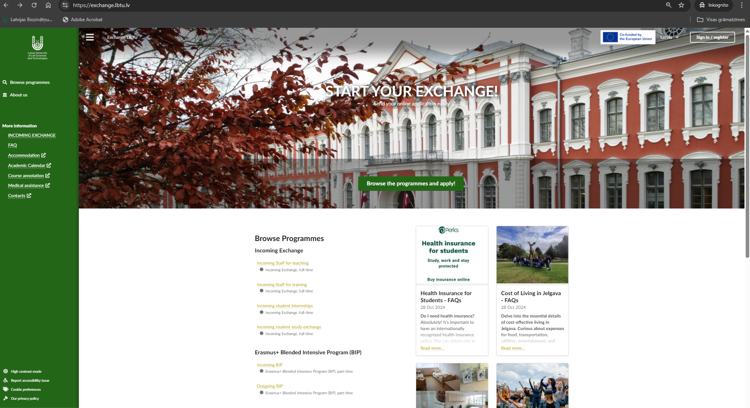
First step: register

Slide 3
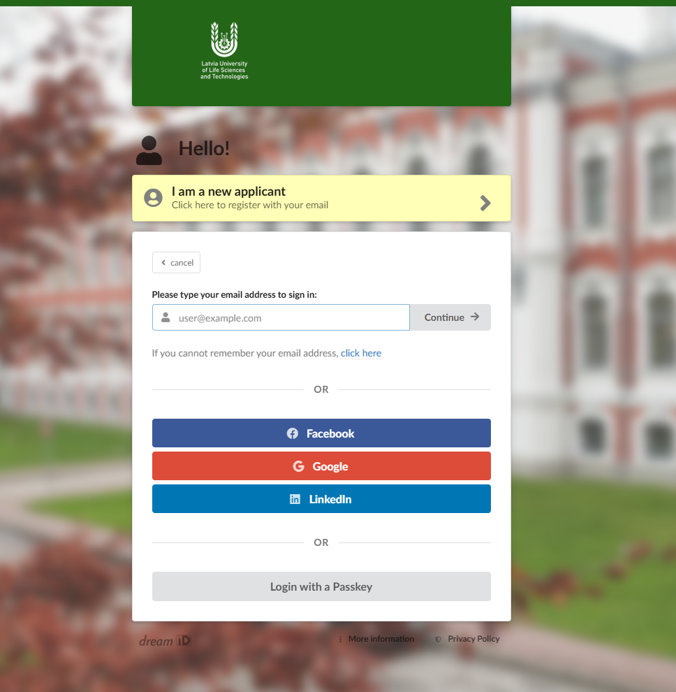
Enter your email.
*You will receive information to this email, regarding your application.

Slide 4
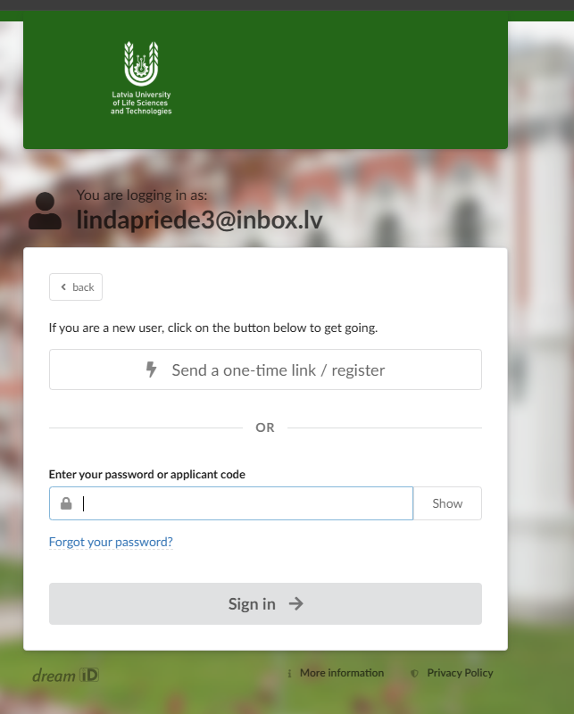
Klik “Send a one-time link” as you are a first time user

Slide 5
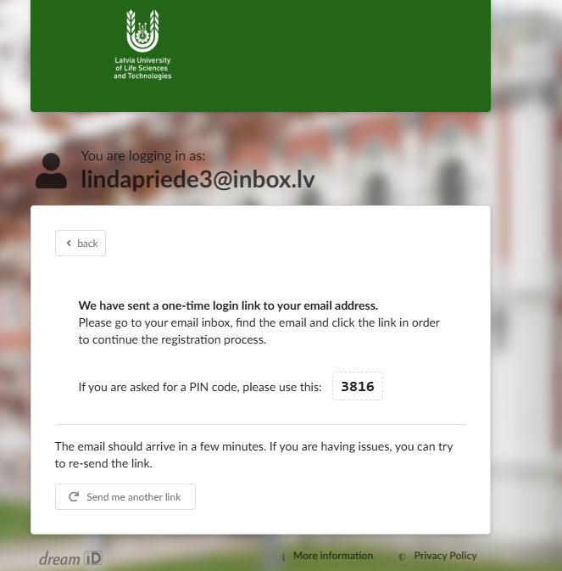
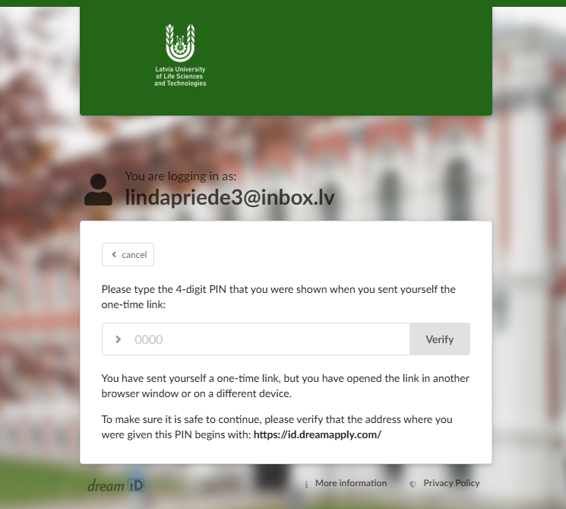
1.
2.

Slide 6
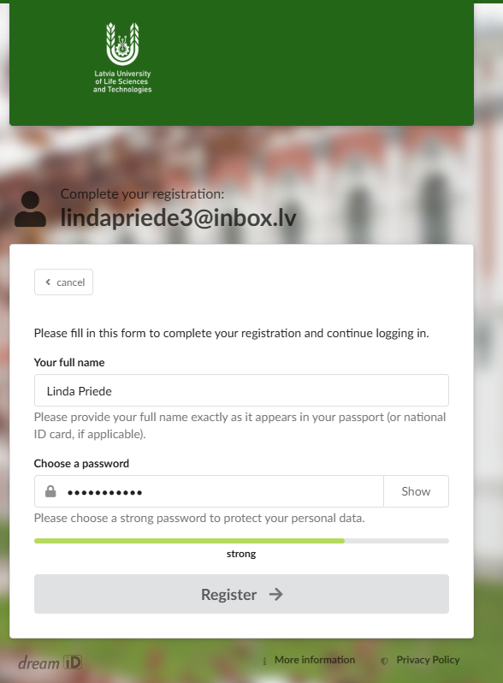
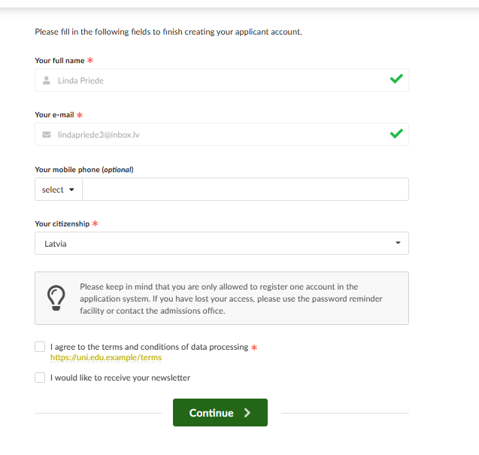
Write your full name and make a password
You need to agree to terms and then click continue

Slide 7
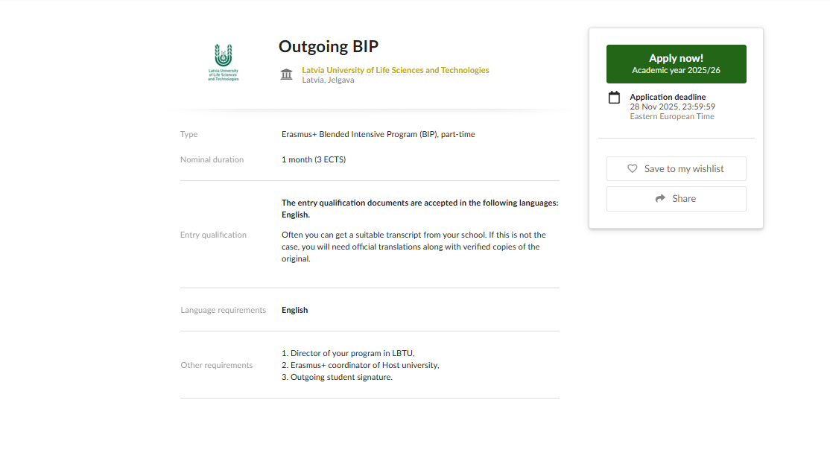
Then click on the program you need to apply for and then click apply now!

Slide 8
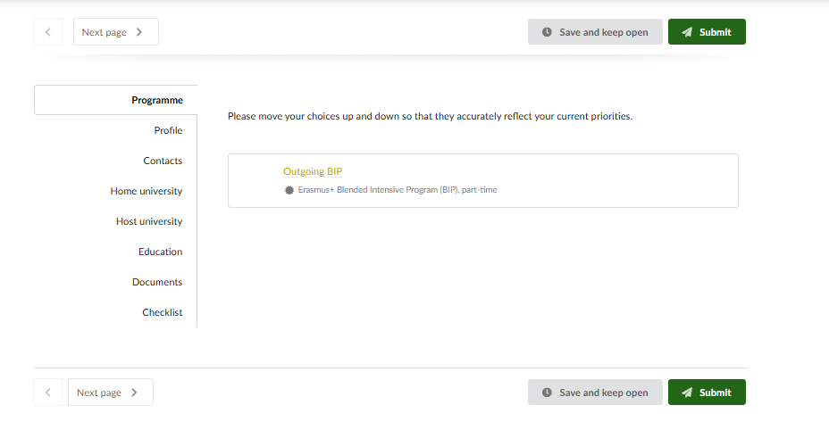
You should fill all the fields (Profile, Contacts, Home university, Education) and in checklist choose your department and also upload your photo.
And last thing to do is to Submit!

