Slide 1
EU Green Deal for Latvia - opportunities and challenges for agricultural and forestry development in the future
Kristīne Sirmā
Head of Sustainable Agriculture Development Division
Department of Agriculture
Email: Kristine.Sirma@zm.gov.lv
University of Life Sciences and Technologies
December 17, 2020
Notes:
1

Slide 2
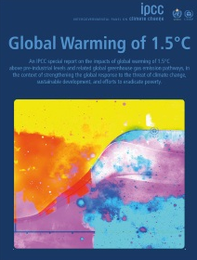
IPCC (Intergovernmental Panel on Climate Change) Special report on the impacts of global warming of 1.5 °C above pre-industrial levels and related global greenhouse gas emission pathways
Headline messages
Current global warming is about 1°C above pre-industrial levels
Regional warming over land is higher than the global average
Warming in the Arctic region is two to three times higher than global average
At current rate, 1,5 °C warming will be exceeded between 2030 and 2052
Current efforts by countries will lead to global warming of 3°C by 2100
Geophysically it is still possible to limit the temperature rise to 1,5°C, but it requires major and immediate transformation
United Nations body for assessing the science related to climate change
Provides regular assessments of the scientific basis of climate change, its impacts and future risks, and options for adaptation and mitigation.
The IPCC currently has 195 members & thousands of people from all over the world contribute to the work of the IPCC
Source: http://www.ipcc.ch/report/sr15/

Slide 3
Climate change is the most significant global risk!
The 5 risks most likely to happen in next 10 years | The 5 risks with biggest impact in next 10 years
1. Extreme weather events | 1. Weapons of mass destruction
2. Natural disasters | 2. Extreme weather events
3. Cyber attacks | 3. Natural disasters
4. Data fraud or theft | 4. Failure of climate change mitigation & adaptation
5. Failure of climate change mitigation & adaptation | 5. Water crises
The Global Risks Report 2018
Source: http://reports.weforum.org/global-risks-2018/

Slide 4
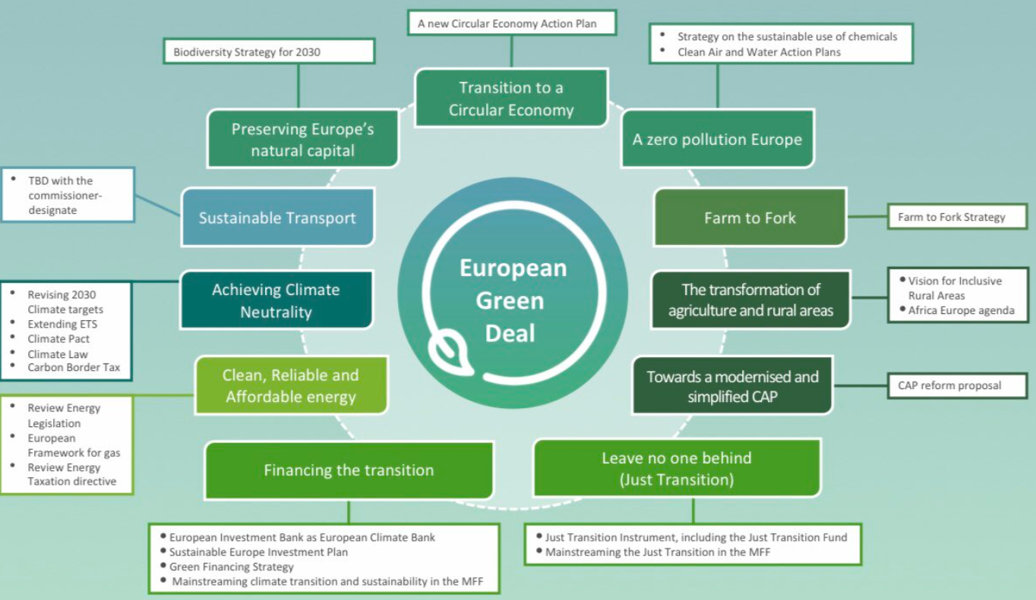
The European Green Deal

Slide 5
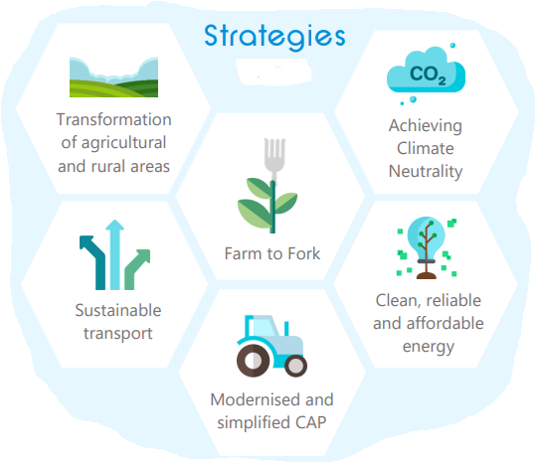
A Green future
Design: Léa Vitali - © European Dairy Association (EDA)

Slide 6
HOW THE BIOECONOMY CONTRIBUTES TO THE EUROPEAN GREEN DEAL:
Climate pact and climate law
Striving for greener industry
Ensuring just transition for all
Investing in smarter, more sustainable transport
Promoting clean energy
Eliminating pollution
Financing green projects
Protecting nature
Making homes energy efficient, renovate
From farm to fork
Leading the green change globally

Slide 7
The nine specific objectives identified for CAP Post 2020
Economic sustainabliy
Climate & environmental goals
Social sustainability
Source: European Commission

Slide 8
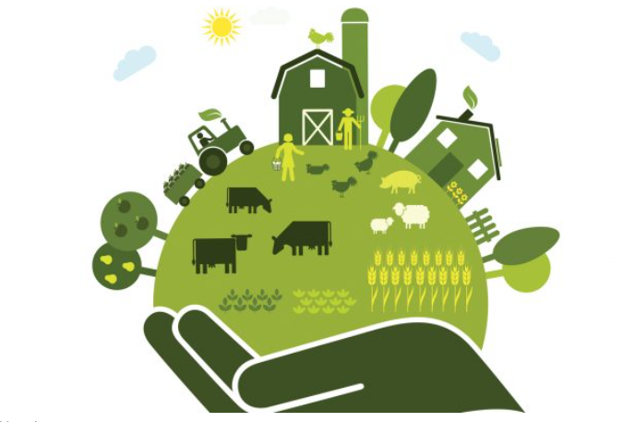
To achieve the goals of EU Green Deal all sectors of the economy will need to take action, investing in new green technologies and supporting innovations
Strategy “From Farm to Fork” is one of the elements of the Green Deal.
The goal of the Strategy is to move to healthier and more sustainable EU food system:
Providing EU inhabitants with healthy, affordable and sustainable food,
Mitigating climate change,
Protecting the environment and conserving the biological diversity,
Creating a fair economic return in the supply chain,
Expanding organic farming,
Reducing food losses and wastage
EU Biodiversity Strategy 2030: one of the elements of the Green Deal. Its goal is to support sustainability both in natural habitats and in agriculture (as decrease of biodiversity and soil degradation have a direct impact on food security). This strategy will work in alignement with the new strategy «From Fark to Fork» and Common Agricultural Policy
Climate neutrality 2050: reduction of GHG emissions, increasing carbon capture

Slide 9
Opportunities & Challenges main keystones

Slide 10
Functional land use
Source: Zemes izmantošanas optimizācijas iespēju novērtējums Latvijas klimata politikas kontekstā https://www.zm.gov.lv/public/ck/files/LVM%20petijums%202.pdf

Slide 11
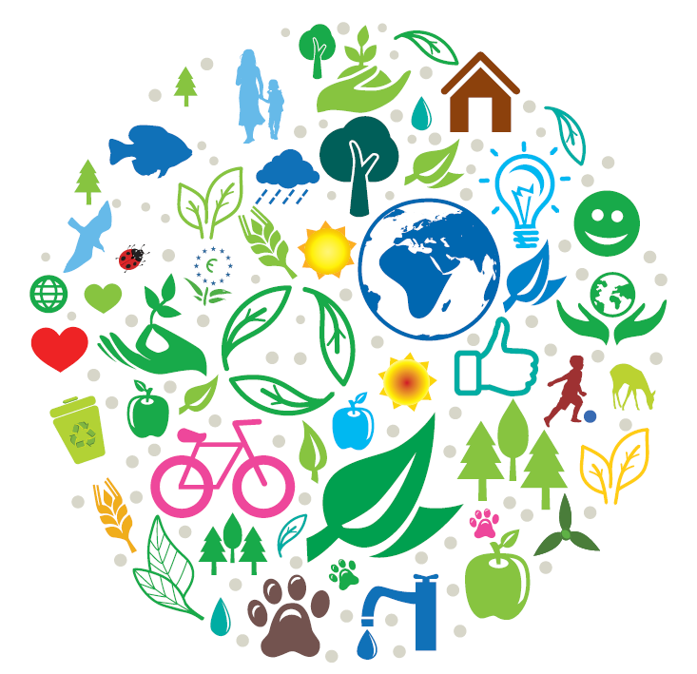
European Green Deal is a Marathon
Frame the indicators
Indicate bottlenecks
Develop case study
Map the risks and lay the groundwork post 2030
Develop and implement roadmap to Climate neutral society
pixabay.com

Slide 12
Sustainable Bioeconomy
«SEE»
Bioeconomy
Environmental
Economic
Social

Slide 13
Thank you!

