Slide 1
Statistical evidence suggestions for transition to sustainable and circular bioeconomy: case Latvia
Biljana Kulišić
Energy Institute Hrvoje Pozar (EIHP)
Dept. RES, Climate and Environmental Protection, Croatia, bkulisic@eihp.hr
Markus Lier
Natural Resources Institute Finland (Luke)
Unit Bioeconomy and Environment, markus.lier@luke.fi

Slide 2
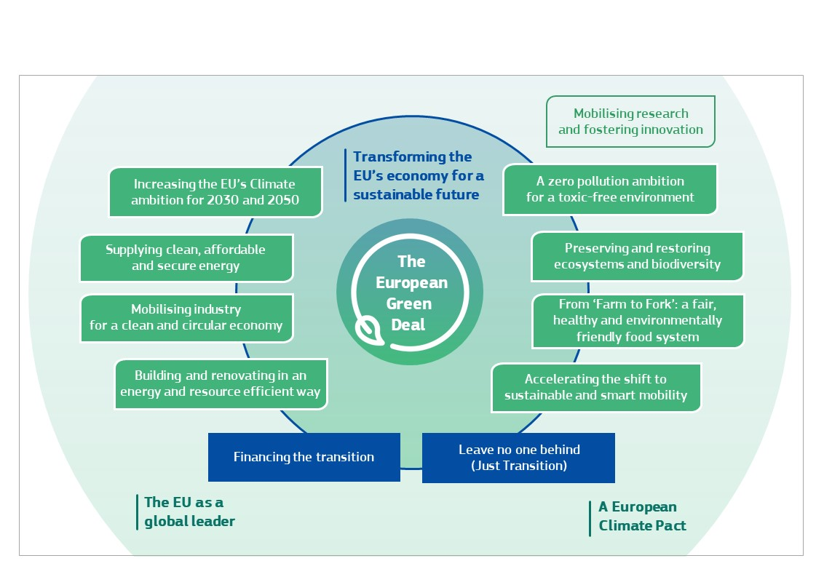
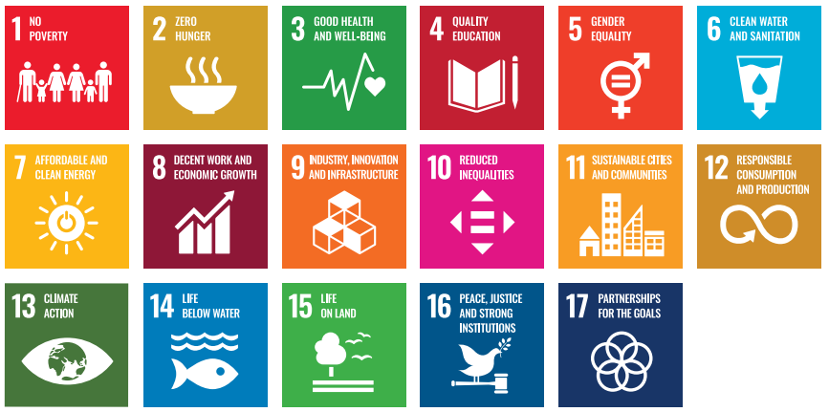
How to align national priorities with the EU vision?
Starting a rapid, policy driven, societal change
EU Bioeconomy goals [1] :
Ensuring food security
Managing natural resources sustainably
Reducing dependence on non-renewable resources
Mitigating and adapting to climate change
Creating jobs and maintaining European competitiveness
[2]
Notes:
Climate Law [4]: “long-term direction of travel for meeting the 2050 climate-neutrality objective through all policies, in a socially-fair and cost-efficient manner”.

Slide 3
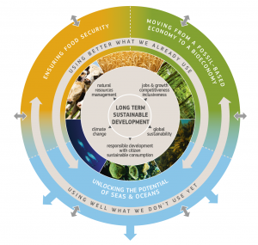
Statistical evidence based bioeconomy policy: the BIOEAST way – using existing data to position bioeconomy towards national priorities
Trade balances
PRODCOM
Structure of the national linear economy
Synergies
Embedded bioeconomy in the national linear economy
Options for decision-makers
Position of a country in the global supply chains
Market players on the bioeconomy supply-demand spectrum
NACE Rev.2
Notes:
We acknowledge the existence of the linear bioeconomy but want to assess its importance, capacities and potentials for overall growth of the nation.

Slide 4
Position in the global value chains: where is “the perfect position” of your country? Can bioeconomy help? [3]
Note: Solid red lines refer to the means for all countries, and the dashed red line refers to the means of the CEE countries.
Notes:
We wanted to see where we are in the global economy.
Global value chains are recent occurence of industry process specialisation.
A country can have 4 broad positions in the GVChs: explain – context
HR: has 4 M population and 56 thousand km2 positioned in between domestic driven and raw materials exporter which is limited position to thrive.

Slide 5
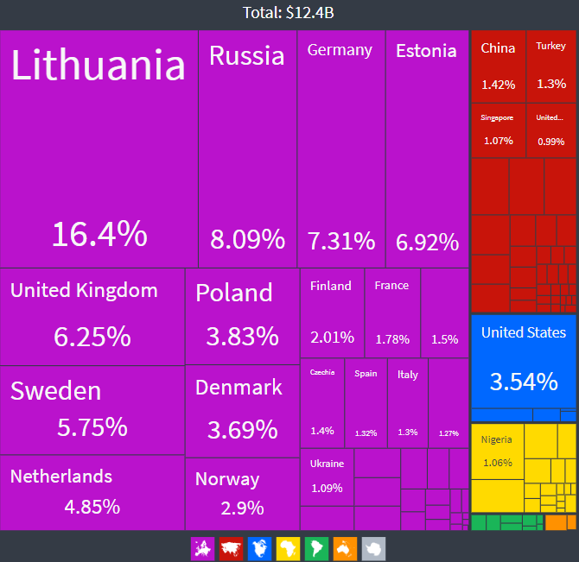
How important is the current bioeconomy? M€ [4]
Export markets of Latvia in 2017 [5]
16291500 | Pellets and briquettes of pressed and agglomerated wood and of wood waste and scrap | 282
16211800 | Other plywood, veneered panels and similar laminated wood, of other wood | 257
16101136 | Pine wood (Pinus sylvestris L.) sawn or chipped lengthwise, sliced or peeled, of a thickness > 6 mm | 248
16101134 | Spruce wood (Picea abies Karst.), fir wood (Abies alba Mill.) sawn or chipped lengthwise, sliced or peeled, of a thickness > 6 mm | 209
10514050 | Grated, powdered, blue-veined and other non-processed cheese (excluding fresh cheese, whey cheese and curd) | 104
100000Z1 | Prepared and preserved meat, meat offal or blood, including prepared meat and offal dishes | 104
16101250 | Wood, sawn or chipped lengthwise, sliced or peeled, of a thickness > 6 mm (excluding coniferous and tropical woods and oak blocks, strips and friezes) | 97
16241133 | Flat pallets and pallet collars of wood | 95
100000Z4 | Crustaceans, molluscs and other aquatic invertebrates and seaweed, frozen, dried, salted, in brine or otherwise prepared or preserved; Fish, otherwise prepared or preserved; Prepared meals and dishes based on fish, crustaceans and molluscs | 88
10711100 | Fresh bread containing by weight in the dry matter state ≤ 5 % of sugars and ≤ 5 % of fat (excluding with added honey; eggs; cheese or fruit) | 81
10131460 | Sausages and similar products of meat, offal or blood and food preparations based thereon (excluding liver sausages and prepared meals and dishes) | 76
16109100 | Treatment; impregnation and preservation of wood (including seasoning and drying) | 75
109010Z0 | Preparations for animal feeds (excluding dog or cat food, p.r.s.) | 74
16232000 | Prefabricated buildings of wood | 70
31091300 | Other wooden furniture (excluding bedroom, dining-, living-room, kitchen, office, shop, medical, surgical, dental/veterinary furniture, cases and cabinets designed for hi-fi, videos and televisions) | 70
10711200 | Cake and pastry products; other bakers’ wares with added sweetening matter | 68
16231150 | Doors and their frames and thresholds, of wood | 67
1st 30 = 50% total value:
17 bio-based products or potentially bio-based products (38% value)
10 wood-based products (34%)
6 farm-fork products (11% value)
1 blue economy (2%)
1st 10 products/289 = 34% total value
10/10 bio-based
Notes:
The top 10 products that are generating the most gross value added to the Latvian economy are bio-based. 45% the existing industrial products’ value is generated from the linear bioeconomy.
Given its size and aspiration to become a small open economy, Latvia has to be an export orientated country. Where does it export? Would the current market share be affected by climate law and carbon dimension of the (bio-based) products?

Slide 6
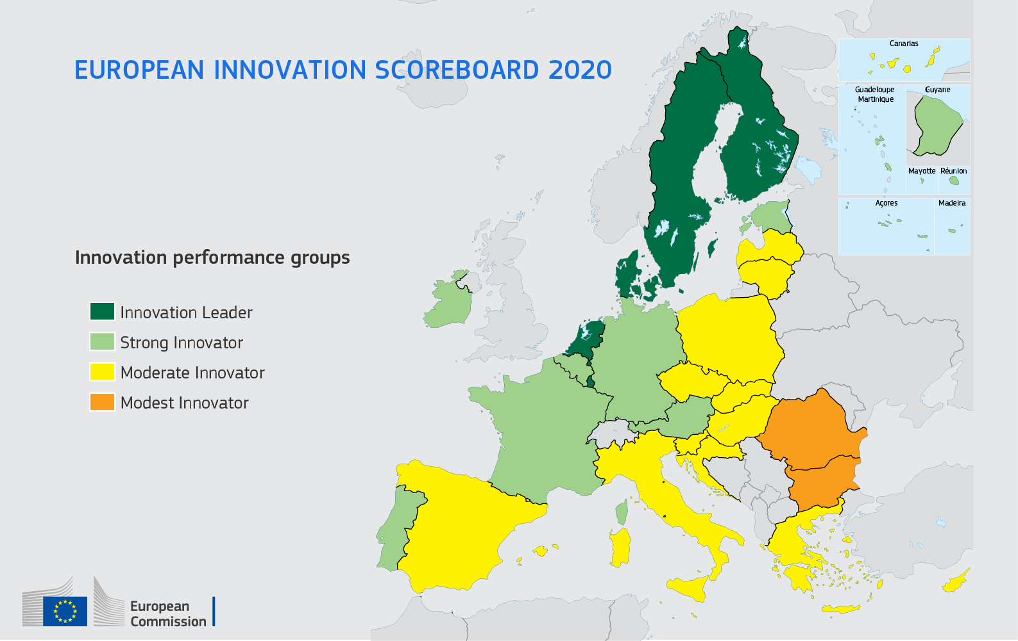
Doing more with less: Synergies with bioeconomy strategy:
Synergy with „industry strategy” in bio-based and potentially bio-based industries.
Overview of energy sector to investigate the needs for synergies with „decarbonisation strategy” [6]
Relative energy intensity (EU27=100): 108
Energy sources by type: give priority to fuel-less energy sources; bioenergy use only when no other renewable source can perform (e.g. high temperatures, process heat, biofuels) or in a synergy (e.g. biogas with freshwater aquaculture)
Energy dependency: reduced to 47.2% in 2016
Prices of energy for industry:
LV pays higher electricity prices than: HR; FR, PL, RO, HU, SK, NL, LT, EE, LU, BG, CZ, SE, FI, DK
LV pays higher natural gas prices than: RO, BG, ES, GR, HR, CZ, HU, BE
What are the most GHG air emitting sectors?
Overview of labour force to investigate the needs for synergies with „educational & demographics strategy” [7]
Net migration
Population projections
PPP
Innovation attractiveness scoreboards [8]
Who are the current and emerging bioeconomy players in your country?
Notes:
Energy intensity is a measure of an economy’s energy efficiency and shows how much energy is needed in order to produce a unit of gross domestic product (GDP). NECP: 196 ktoe per EURO 1M GDP – to be maintained
One of the priorities of the EU strategy is to increase energy efficiency to reduce energy consumption by 32.5 % by 2030.

Slide 7
The highest CO2e emitting sectors in Latvia [9]
H Transportation and storage: 38% (17% of GVA; 16% of employment)
D Electricity, gas, steam and air conditioning supply: 27% (5% of GVA; 2% of employment)
C Manufacture: 18% (23% of GVA; 21% of employment) +
= 83% CO2e in total
In Latvia, that would mean 39% of the workforce and 55% of the GVA, excluding the public sector.

Slide 8
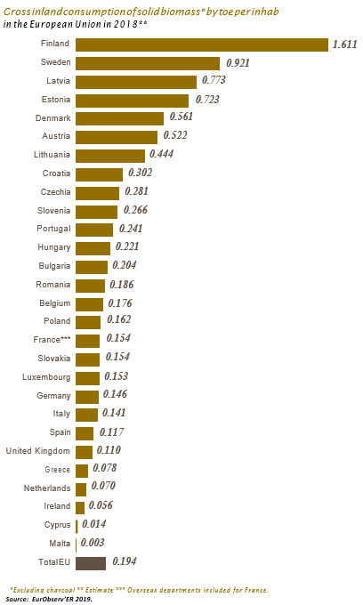
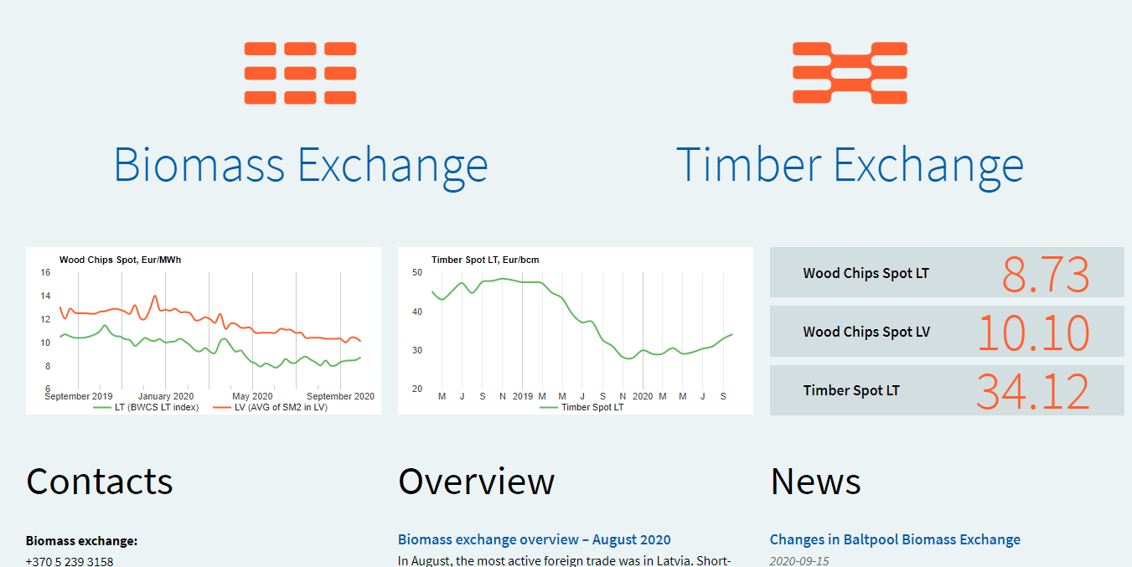
The state of the art of bioenergy in Latvia [10,11]
- 1.046 GWh primary production of biogas
- 570 GWh of electricity from solid biofuels
36.7 ktoe of total consumption from biofuels in transport
9.7 ktoe bioethanol
27.0 ktoe biodiesel
2.4 Mtoe from solid biomass primary energy production
1.5 Mtoe from solid biomass gross inland consumption
Bioelectricity generates ~320 direct jobs in Latvia [12]

Slide 9
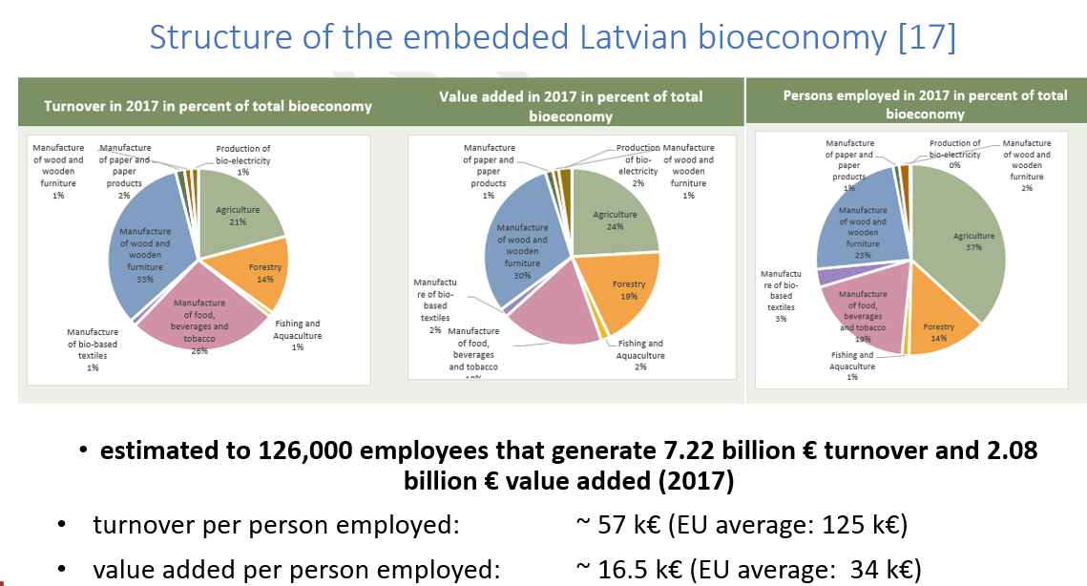
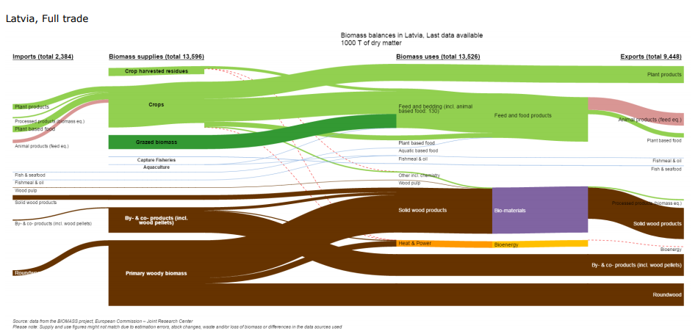
Source [16]
[13,14]
Notes:
The “Field to fork” chain: about 43 % of the added value in the bioeconomy and 56 % of the persons employed within the bioeconomy sectors.
forest-based: accounted for 51% of the value added and 38% of the bioeconomy employment.
More labour-productive sectors, such as the manufacture of bio-based chemicals, pharmaceuticals, plastics and rubber, accounted for 3% of the value added, corresponding to 1% of the person employed in bioeconomy.
Blue bioeconomy- 2% VA and 1% employment

Slide 10
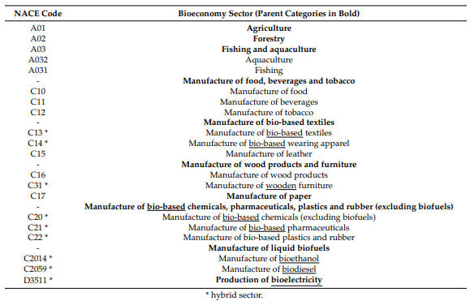
VA per employed person in the Latvian bioeconomy, by sector
1 = Average VA per employee for LV bioeconomy
bC16-bC31 Manufacture of wood and wooden furniture: 29% higher VA per employee
Source [12,15,16]
Notes:
estimated to 847,000 employees that generate 13.92 billion € turnover and 3.99 billion € value added (2017)
turnover per person employed: ~ 16.4 k€ (EU average: 125 k€)
value added per person employed: ~ 4.7 k€ (EU average: 34 k€)
Manufacture of paper-based packaging

Slide 11
Bioeconomy champions in LV [12,15,16]
bC2059 | Manufacture of other bio-based chemical products n.e.c. | 3
bC1621 | Manufacture of bio-based veneer sheets and wood-based panels | 2.758
C1041 | Manufacture of oils and fats | 113
C1101 | Distilling, rectifying and blending of spirits | 751
C1084 | Manufacture of condiments and seasonings | 340
bC2030 | Manufacture of bio-based paints, varnishes and similar coatings, printing ink and mastics | 4
C1091 | Manufacture of prepared feeds for farm animals | 298
bC1629 | Manufacture of other wood; manufacture of bio-based articles of cork, straw and plaiting materials | 1.909
bC2211 | Manufacture of bio-based rubber tyres and tubes; retreading and rebuilding of rubber tyres | 13
bC1721 | Manufacture of corrugated paper and paperboard and of containers of paper and paperboard | 758
bC2222 | Manufacture of bio-based plastic packing goods | 2
bC1729 | Manufacture of other articles of paper and paperboard | 437
bC2015 | Manufacture of bio-based fertilisers and nitrogen compounds | 285
C1051 | Operation of dairies and cheese making | 3.114
C1083 | Processing of tea and coffee | 198
bC1610 | Sawmilling and planing of wood | 12.632
C1082 | Manufacture of cocoa, chocolate and sugar confectionery | 1.171
C1105 | Manufacture of beer | 734
C1107 | Manufacture of soft drinks; production of mineral waters and other bottled waters | 925
bC2014 | Manufacture of other bio-based organic basic chemicals | 532
Notes:
Pellets and briquettes of pressed and agglomerated wood and of wood waste and scrap
Other plywood, veneered panels and similar laminated wood, of other wood
Pine wood (Pinus sylvestris L.) sawn or chipped lengthwise, sliced or peeled, of a thickness > 6 mm
Spruce wood (Picea abies Karst.), fir wood (Abies alba Mill.) sawn or chipped lengthwise, sliced or peeled, of a thickness > 6 mm
Grated, powdered, blue-veined and other non-processed cheese (excluding fresh cheese, whey cheese and curd)
Prepared and preserved meat, meat offal or blood, including prepared meat and offal dishes
Wood, sawn or chipped lengthwise, sliced or peeled, of a thickness > 6 mm (excluding coniferous and tropical woods and oak blocks, strips and friezes)
Flat pallets and pallet collars of wood
Crustaceans, molluscs and other aquatic invertebrates and seaweed, frozen, dried, salted, in brine or otherwise prepared or preserved; Fish, otherwise prepared or preserved; Prepared meals and dishes based on fish, crustaceans and molluscs
Fresh bread containing by weight in the dry matter state ≤ 5 % of sugars and ≤ 5 % of fat (excluding with added honey; eggs; cheese or fruit)

Slide 12
Statistical evidence based bioeconomy policy options for Latvia
Bio-based products highly represented in the PRODCOM – transition to sustainable and circular bioeconomy: linking with the Clean Energy transition to ensure carbon neutrality and reduce price of electricity, energy dependency (National Climate Energy Action Plan) and sustainability certification schemes (FSC…)
Investigating if there is a chance for growth through Farm to Fork by linking primary production with the industry that produces PRODCOM products
Capacity to develop both blue, green and brown bioeconomy: focusing on those that are having greater value added
Blue bioeconomy (2% of VA and 37% above the average) as a competitive advantage to provide biomass base to support bioeconomy champions: R&D waste streams and algae
Wood-based bioeconomy (51% of VA and 36% above the average) with cascading use of biomass and heat from bioenergy (CHP) or high-temperature heat pumps to improve the competitiveness & carbon neutrality – untapped potential with a source of renewable CO2!
Biomass exchange / bio-hubs: BALTPOOL - LT
“Farm to fork”: 43% of VA, 68% of average VA: focus on dairy industry (28% higher VA/emp. than national average) and top PRODCOM products to transition to S&C bioeconomy – spin offs and decarbonisation
Transition of non - integrated biorefineries to bioeconomy to support transition of the top bio-based PRODCOM products & bioeconomy champions
Strong education & focusing on high-VA bio-based industries with less labour intensity / vocational training.
4.2
NA
4.5
4.7
4.3
4.2
4.2
4.6
4.3
Notes:
forest-based: accounted for 51% of the value added and 38% of the bioeconomy employment.
CO2: Large quantities are produced and consumed at industrial sites making fertilizers, plastics and rubber.
Carbon dioxide is commonly used as a raw material for production of various chemicals; for freezing of food products such as poultry, meats, vegetables and fruit; for chilling of meats prior to grinding; for refrigeration and maintenance of ideal atmospheric conditions during transportation of food products to market…

Slide 13
2050: a sustainable, carbon-neutral society
Foresight Exercise
2030
National Bioeconomy Action Plan & SRIA
2020
evidence-based statistical data,
verified by the national stakeholders
Notes:
We had 11 country focused virtual roundtables to grade the relevance of the statistical evidence for the bioeconomy strategy development. This was verified by 250 stakeholders in the BIOEAST region.

Slide 14
Sources:
[1] EC: Review of the 2012 European Bioeconomy Strategy, DG RTD, COM(2018) 763 final. Available at: https://ec.europa.eu/research/bioeconomy/pdf/review_of_2012_eu_bes.pdf#view=fit&pagemode=none
[2] COMMUNICATION FROM THE COMMISSION TO THE EUROPEAN PARLIAMENT, THE EUROPEAN COUNCIL, THE COUNCIL, THE EUROPEAN ECONOMIC AND SOCIAL COMMITTEE AND THE COMMITTEE OF THE REGIONS The European Green Deal. COM/2019/640 final; available at https://eur-lex.europa.eu/legal-content/EN/TXT/?qid=1576150542719&uri=COM%3A2019%3A640%3AFIN
[3] Vidaković Peruško, I.; Kovač, K.; Jošić M. Croatia in Global Value Chains. Surveys S-32; Croatian National Bank, Zagreb, February 2018
[4] Eurostat: PRODCOM Annual Dana 2019, available at: https://ec.europa.eu/eurostat/documents/120432/10398214/Prodcom+Annual+Data+2019/9e1da95d-1223-a4e0-6bcf-839c33bffd85
[5] OECD Country profile: Croatia, available at: https://oec.world/en/profile/country/hrv/, accessed at 23 February 2020.
[6] Eurostat: Shedding light on energy in the EU - A GUIDED TOUR OF ENERGY STATISTICS, 2020 Edition, https://ec.europa.eu/eurostat/cache/infographs/energy/bloc-4b.html
[7] Lutz, W., Amran, G., Belanger, A., Conte, A., Gailey, N., Ghio, D., Grapsa, E., Jensen, K., Loichinger, E., Marois, G., Muttarak, R., Potancokova, M., Sabourin, P. and Stonawski, M., Demographic Scenarios for the EU, EUR 29739 EN, Publications Office of the European Union, Luxembourg, 2019, ISBN 978-92-76-03216-8
[8] European innovation scoreboard https://ec.europa.eu/growth/industry/policy/innovation/scoreboards_en#:~:text=The%20European%20innovation%20scoreboard%20provides,areas%20they%20need%20to%20address.
[9] Eurostat: Greenhouse gas emission statistics - air emissions accounts; https://ec.europa.eu/eurostat/statistics-explained/index.php?title=Greenhouse_gas_emission_statistics_-_air_emissions_accounts
[10] Eurobserv’er, 2020: Biofuels Barometer. Available at: https://www.eurobserv-er.org/category/all-biofuels-barometers/
[11] Bioenergy Europe, 2020. Statistical Report 2019. Available at: https://bioenergyeurope.org/article/101-statistical-report-2019.html
[12] JRC, Socioeconomic Indicators to Monitor the EU’s Bioeconomy in Transition; https://datam.jrc.ec.europa.eu/datam/mashup/BIOECONOMICS/index.html?rdr=1591178537080
[13] Gurría, P., Ronzon, T., Tamosiunas, S., López, R., García Condado, S., Guillén, J.,Cazzaniga, N. E., Jonsson, R., Banja, M., Fiore, G., M'Barek R., Biomass flows in the European Union: The Sankey Biomass diagram- towards a cross-set integration of biomass, EUR 28565 EN, doi:10.2760/352412 available at https://datam.jrc.ec.europa.eu/datam/mashup/BIOMASS_FLOWS/index.html#
[14[ JRC: Biomass flows: https://knowledge4policy.ec.europa.eu/visualisation/biomass-flows_en
[15] Ronzon, T.; Piotrowski, S.; Tamosiunas, S.; Dammer, L.; Carus, M.; M’Barek, R. Developments of Economic Growth and Employment in Bioeconomy Sectors across the EU. Sustainability 2020, 12, 4507.
[16] Gurría, P., Ronzon, T., Tamosiunas, S., López, R., García Condado, S., Guillén, J.,Cazzaniga, N. E., Jonsson, R., Banja, M., Fiore, G., M'Barek R., Biomass flows in the European Union: The Sankey Biomass diagram- towards a cross-set integration of biomass, EUR 28565 EN, doi:10.2760/352412 available at https://datam.jrc.ec.europa.eu/datam/mashup/BIOMASS_FLOWS/index.html#

Slide 15
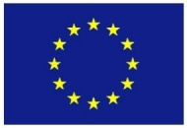
Thank you for your attention
www.bioeast.eu/bioeastsup
This project has received funding from the European Union’s Horizon 2020 research and innovation programme under Grant Agreement No 862699

