Slide 1
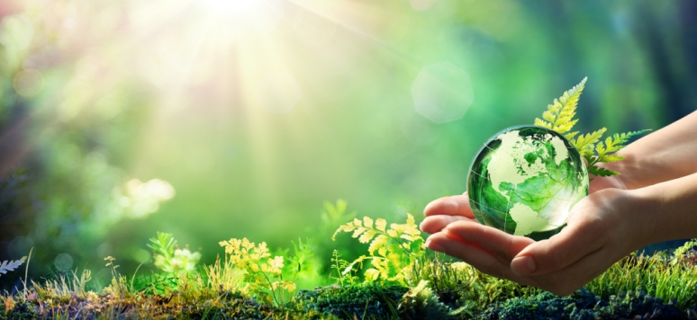


Challenges for city agriculture related to the development strategy European Green Deal
D h. c. Dr hab. Maria Parlińska, Professor UTH
Conference EUROPEAN GREEN DEAL FOR BIOECONOMY DEVELOPMENT
17 December 2020,

Slide 2

Agenda
Introduction
European Green Deal
Theoretical background of the Urban Agriculture
Urban Agriculture historical perspective
Urban Agriculture today
Green Cities
Conclusion

Slide 3
Introduction
Throughout the 70s and 90s of 20ty century, an economic policy to move the United States economy away from non-renewable energy was developed by activists in the labour and the environmental movements. (Cobb, David, 2019)
An early use of the phrase "Green New Deal" was by journalist Thomas Friedman. (Kaufman, Alexander C, 2018) He argued in favour of the idea in The New York Times and The New York Times Magazine

Slide 4
Introduction
„If you have put a windmill in your yard or some solar panels on your roof, bless your heart. But we will only green the world when we change the very nature of the electricity grid – moving it away from dirty coal or oil to clean coal and renewables. And that is a huge industrial project – much bigger than anyone has told you. Finally, like the New Deal, if we undertake the green version, it has the potential to create a whole new clean power industry to spur our economy into the 21st century.”
Thomas Friedman

Slide 5
Introduction
In December 2019, the European Council, driven by the need to intensify global climate action and in line with the Paris Agreement,
At the same time, the European Commission has presented a new development strategy - the European Green Deal (European Commission, 2019),

Slide 6
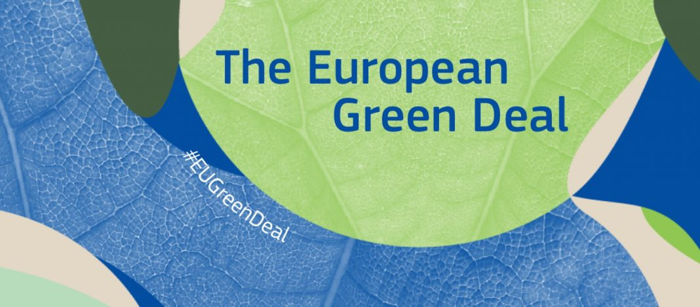
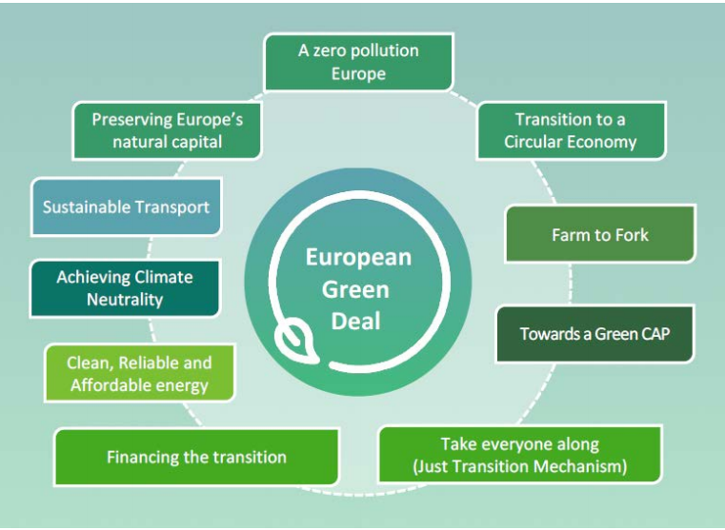
The European Green Deal

Slide 7
The European Green Deal
The following links shows the actions set out in the strategy of the possible action in the field of agriculture:
  Reduction of greenhouse gas emissions.
  A new industrial strategy will be developed, including processing, which, together with the circular economy action plan, will ensure a transformation towards.
  Strategy “farm to fork”.
  Strategy for biodiversity (e.g. greening cities)
  Introduction of innovative solutions.
  Implementation of the strategy with EU financial instruments.

Slide 8
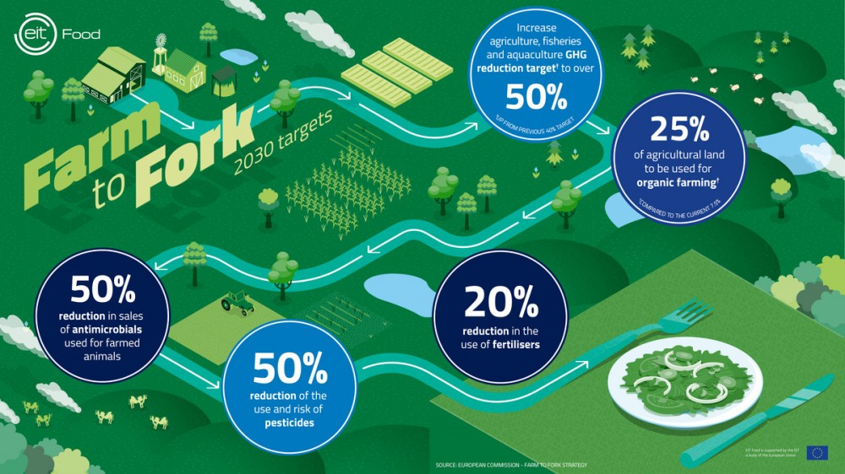
The European Green Deal

Slide 9
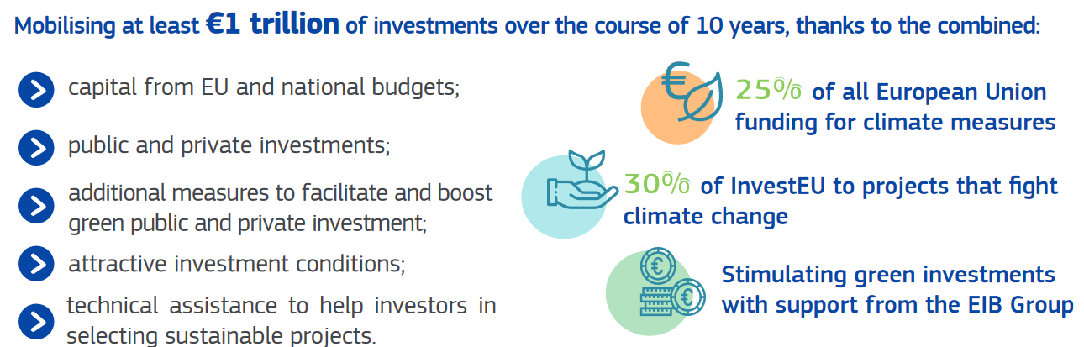
Investment Plan
Source: Investing in a Climate-Neutral and Circular Economy

Slide 10
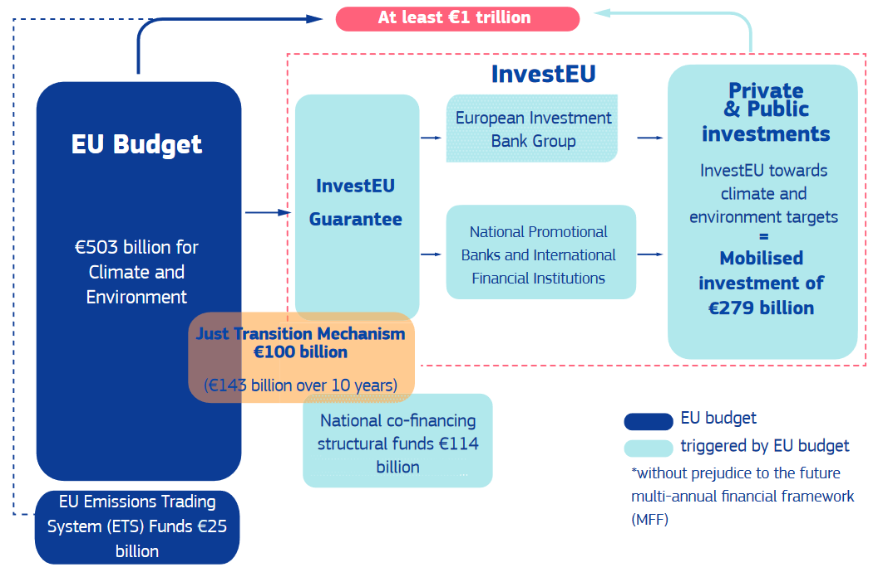
Where will the money come from?
Source: Investing in a Climate-Neutral and Circular Economy

Slide 11
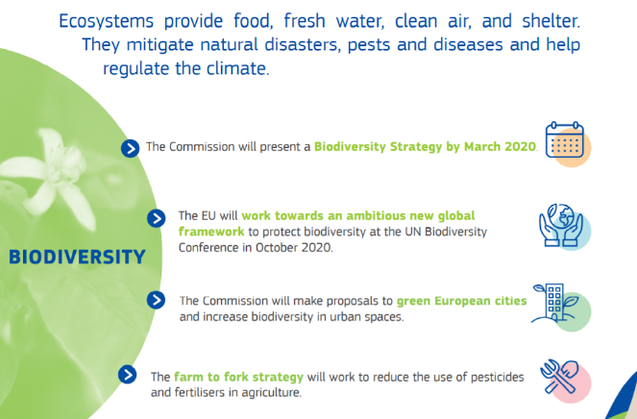
European Institutions and European citizens in rural and in urban areas should work together to:
Build a new partnership between rural and urban communities.
Strengthen the role of rural communities in all aspects of the Green Deal.
Begin the transition to sustainable food systems.

Slide 12
Green Infrastructure
Encompass connected networks of multifunctional, predominantly unbuilt, space that supports both ecological and social activities and processes (Kambites and Owen, 2006).
A multifunctional resource, capable of delivering those ecological services and quality of life benefits required by the communities it serves, and needed to underpin sustainability (Natural England, 2009).
A process that promotes a systematic and strategic approach to land conservation of the national, state, regional and local scales encouraging land-use planning and practices that are good for nature and people (Benedict and McMahon, 2006).

Slide 13
Green Infrastructure elements
Urban Green Spaces (UGS) - areas of the landscape that are predominantly composed of vegetated land and water bodies within an urban setup. These include urban parks, greenways, street trees, esplanades and gardens among others, and are seen to provide both salve and respite from the deleterious effects of urbanization (Waldheim 2006).

Slide 14
Green Infrastructure elements
Urban Agriculture (UA) - is the practice of growing food and fuels within the daily rhythm of the city or town, produced directly for the market and frequently produced and marketed by the farmers themselves or their associates (Smit and Nasr, 1992).

Slide 15
Green Infrastructure elements
Urban Agriculture Includes:
  aquaculture in tanks, ponds, rivers,and coastal bays.
  livestock raised in backyards, along roadsides, and within utilities rights-of-way.
  orchards including vineyards, street trees, backyard trees,
  vegetables and other crops grown on roof tops, backyards, vacant lots of industrial estates along canals, on the grounds of institutions, on road sides and in many suburban small farms.

Slide 16
Urban Agriculture - historical perspective
Urban farming is mentioned to have been practiced in Ancient Egypt and Machu Pichu among other ancient civilizations.
In Utopia, Thomas Moore wrote about the gardens in Amaurot the capital city of Utopia, as having gardens behind their houses full of vines, fruits, herbs and flowers.

Slide 17
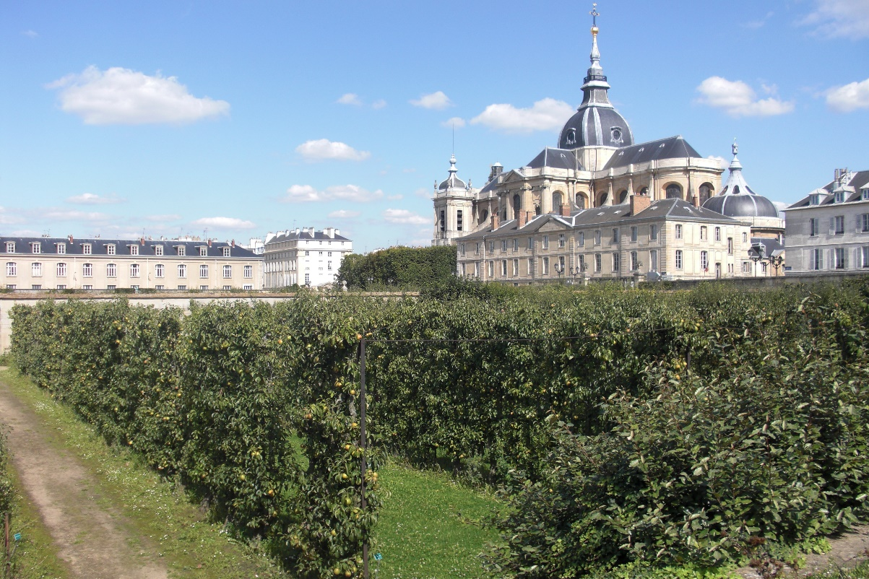
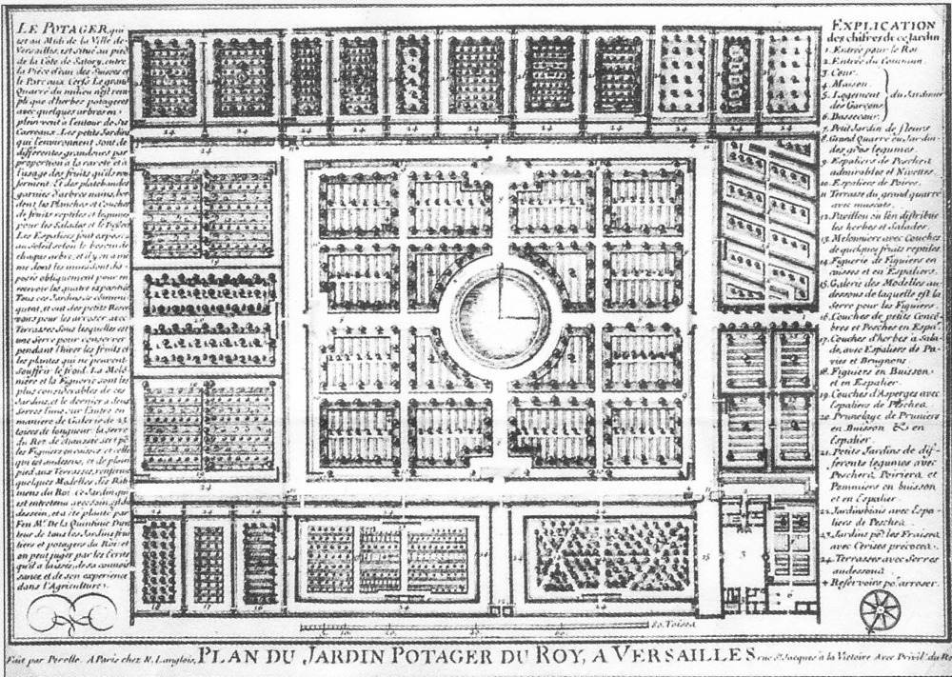
Urban Agriculture - historical perspective
the royal vegetable garden in Versailles, which provided fresh fruit and vegetables to the royal table of Louis XIV.
http://thisisversaillesmadame.blogspot.com/2013/11/the-kings-kitchen-garden.html

Slide 18
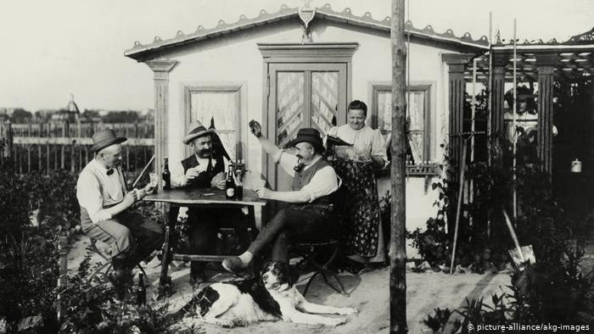
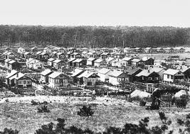
Urban Agriculture
- historical perspective
‘Schreber’s gardens’, ‘allotments’ or ‘family gardens’, „garden for workers’ these individual plots are merged into huge gardens, separated by fences.
This phenomenon was born in 1864 and there are now over 39,000 Schrebergärten in Leipzig.
Their central part was to occupy the lawn - children's play area, and fruit and vegetables were to be grown around it (as part of children's environmental education);

Slide 19
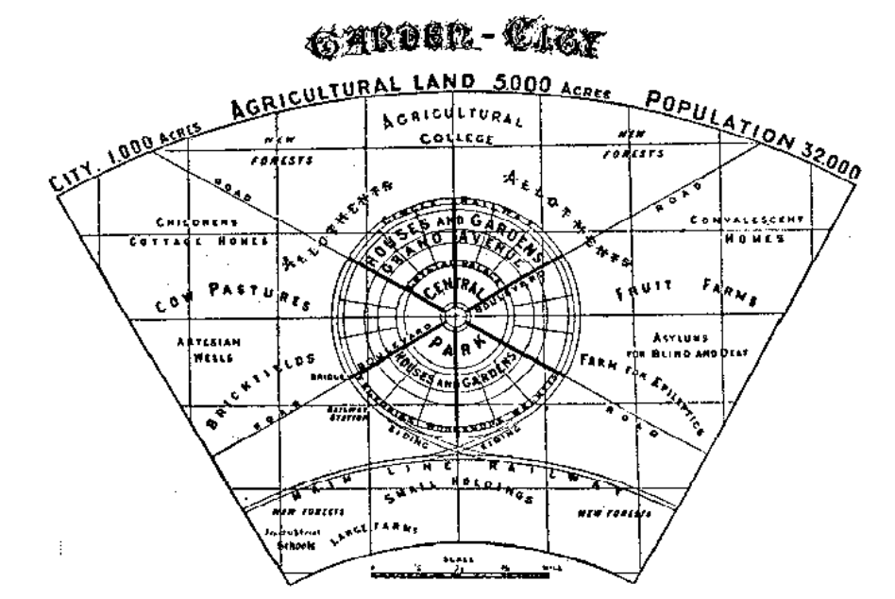
Urban Agriculture - historical perspective
The Garden City, a model unit of 32,000 people surrounded by 5000 acres of agricultural land so that the city can feed itself
Source: Howard, 1902

Slide 20
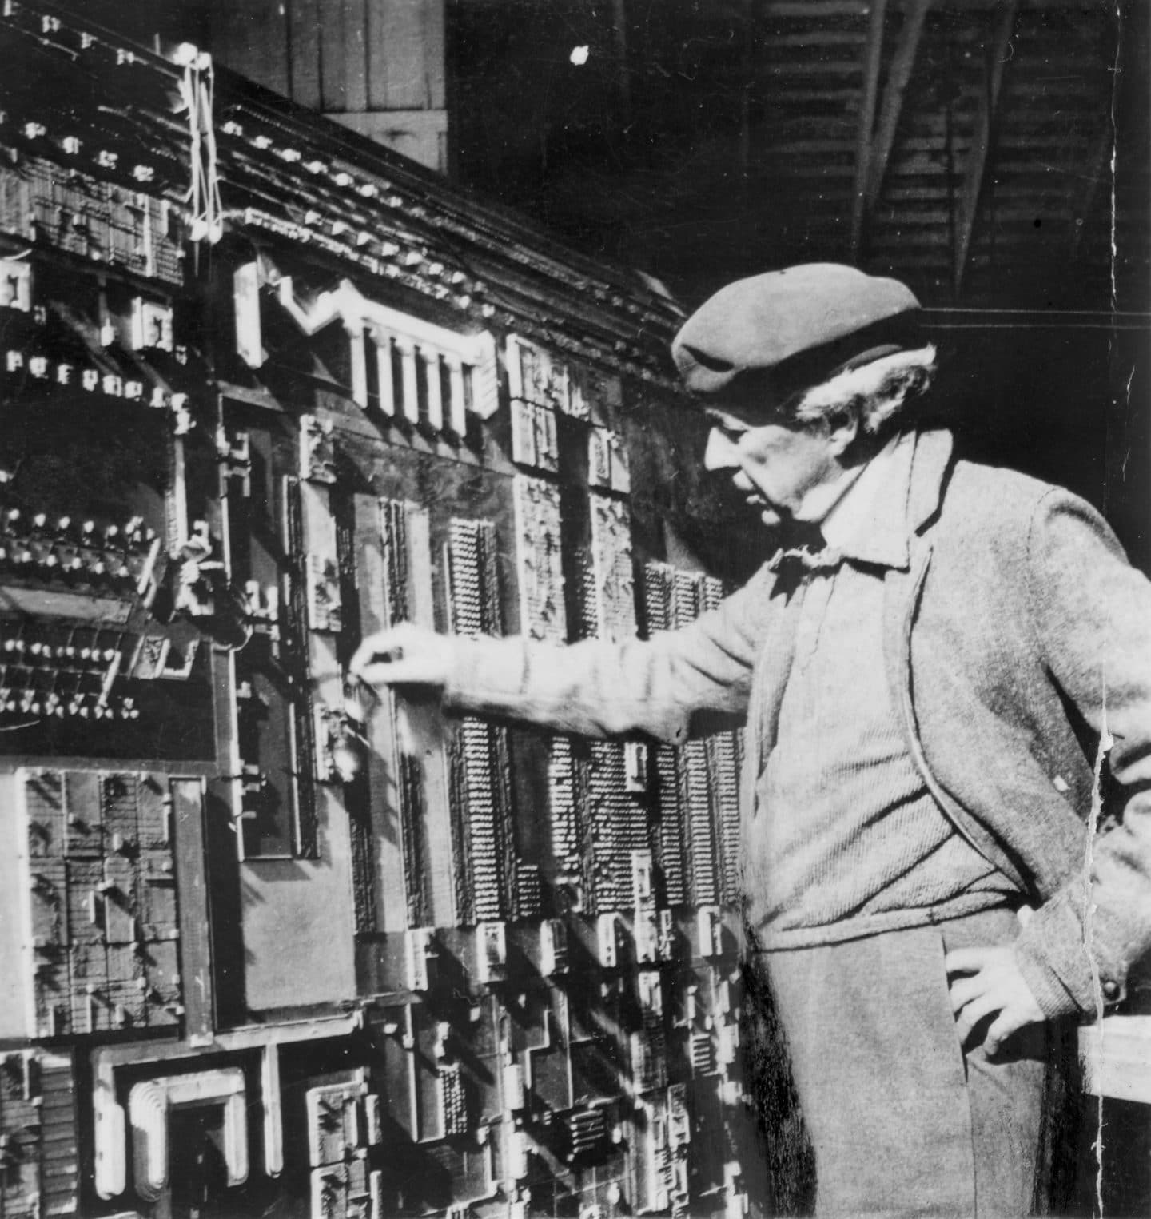
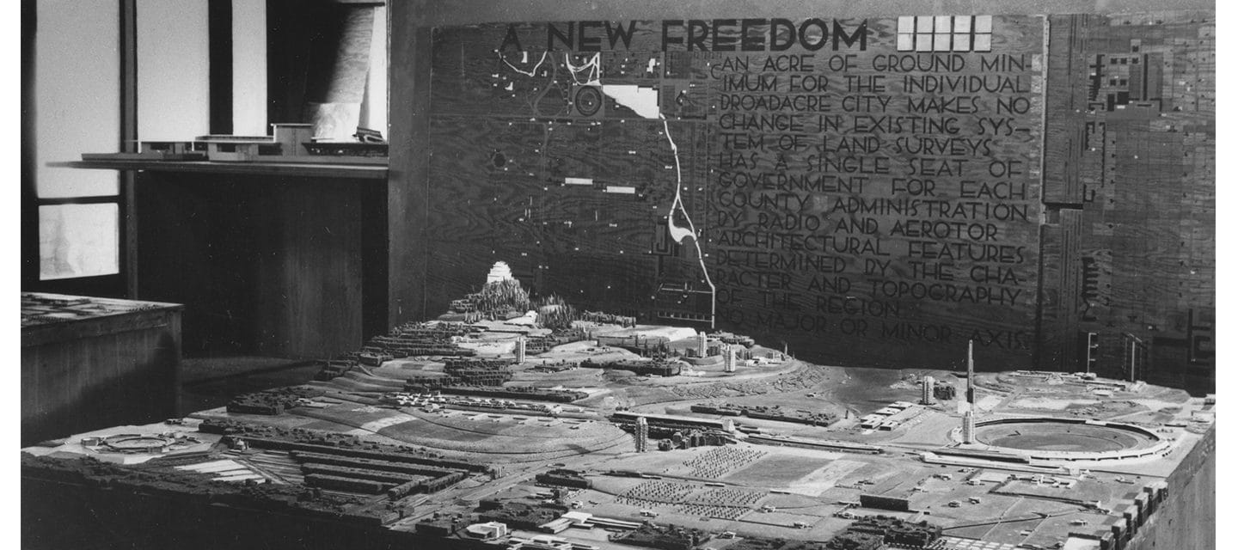
Urban Agriculture - historical perspective
Revisiting Frank Lloyd Wright’s Vision for “Broadacre City”
the vision of the famous Frank Lloyd Wright, who during the economic crisis of the 1930s created the concept of Broadacre City - a metropolis connecting city and countryside, as a recipe for urban problems
https://franklloydwright.org/revisiting-frank-lloyd-wrights-vision-broadacre-city/

Slide 21
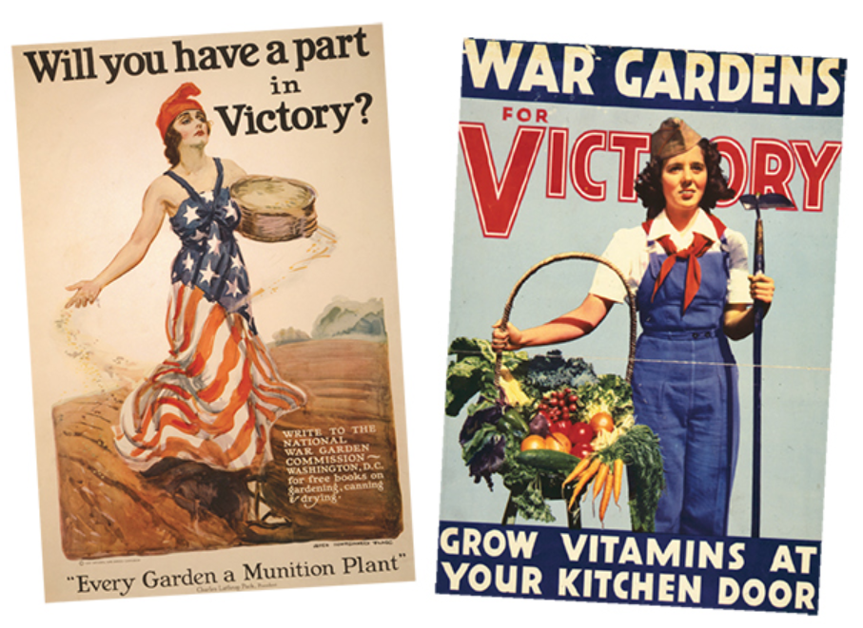
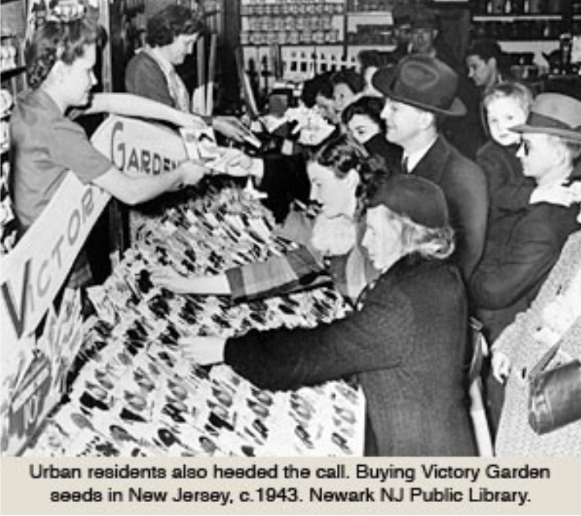
Urban Agriculture - historical perspective
Urban Agriculture today
https://www.quintessentialbarrington.com/ja19-feature-victory-gardens.html
https://livinghistoryfarm.org/farminginthe40s/crops-3/victory-gardens/

Slide 22
Urban Agriculture today
Community Garden - a single piece of land gardened collectively by a group of people), and allotment garden/ Kleingarten / Schrebergarten (plots formed by subdividing a piece of land into a few or up to several hundreds of land parcels that are assigned to individuals or families.
Other: urban farming, roof top gardens, green houses, vertical farms, stacked green houses, and plant factories

Slide 23
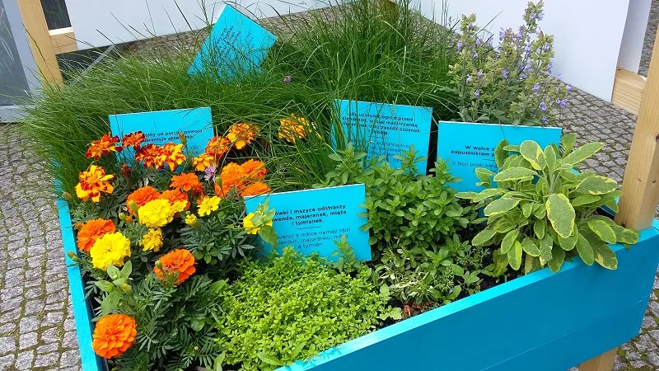
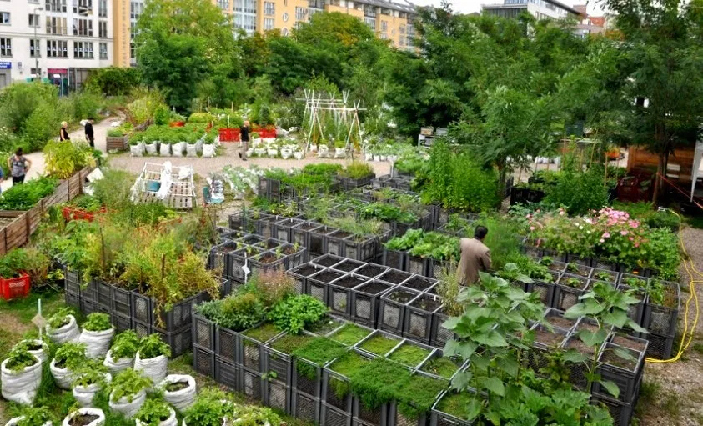
Urban Agriculture today definition
Urban farming is becoming more and more popular. Systematic migration from rural to urban areas is associated with progressive urbanization, an increase in the number of people, and hence - the need for increased food production and decreasing stocks of agricultural land.
One of the solutions used in urban agriculture are employee allotment gardens or the so-called roof farms.
http://fundacjamy.com/in-english/projects-foundation-we-poland/community-gardens/

Slide 24
Urban Agriculture today
The main goal of urban agriculture is to create a model that gives the highest quality crops while ensuring maximum protection of the natural environment and ensuring the local community has access to urban farms.
Urban farming, in addition to the traditional basic activities related to production, processing, distribution and consumption, also provides many other benefits. These benefits include: the possibility of recreation and relaxation for seniors and families with children, among greenery, new landscaping, increasing the biologically active surface in cities, as well as increasing environmental awareness among city dwellers.

Slide 25
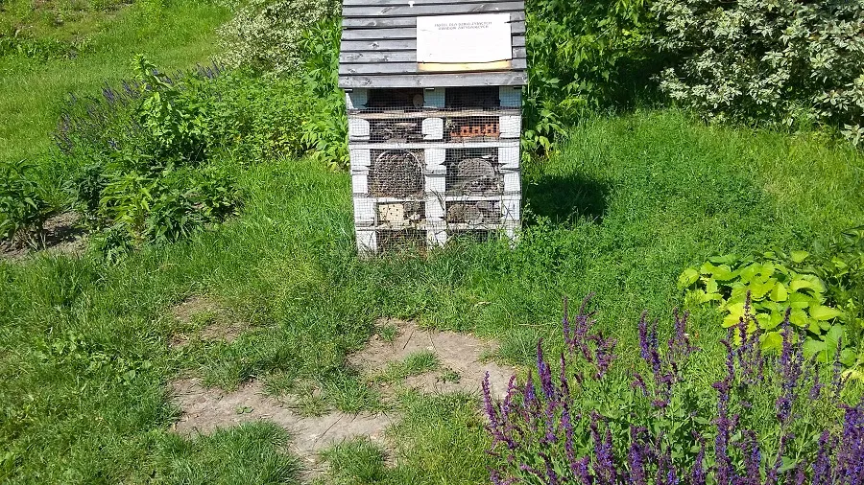
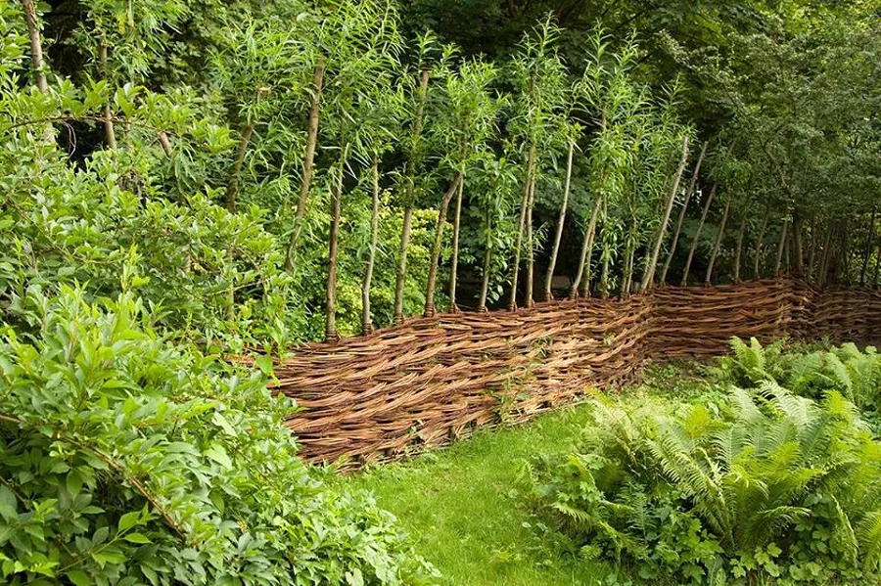
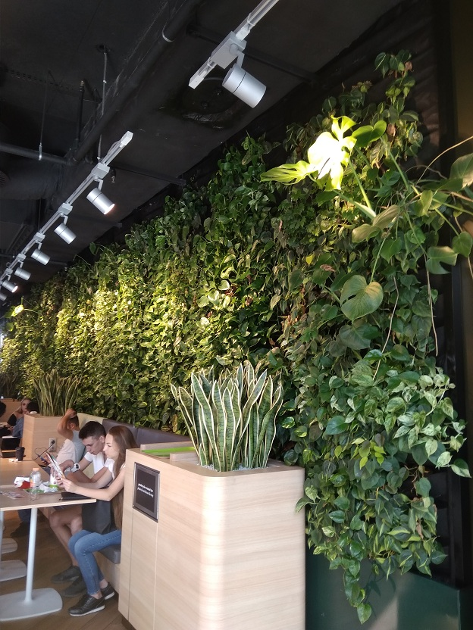
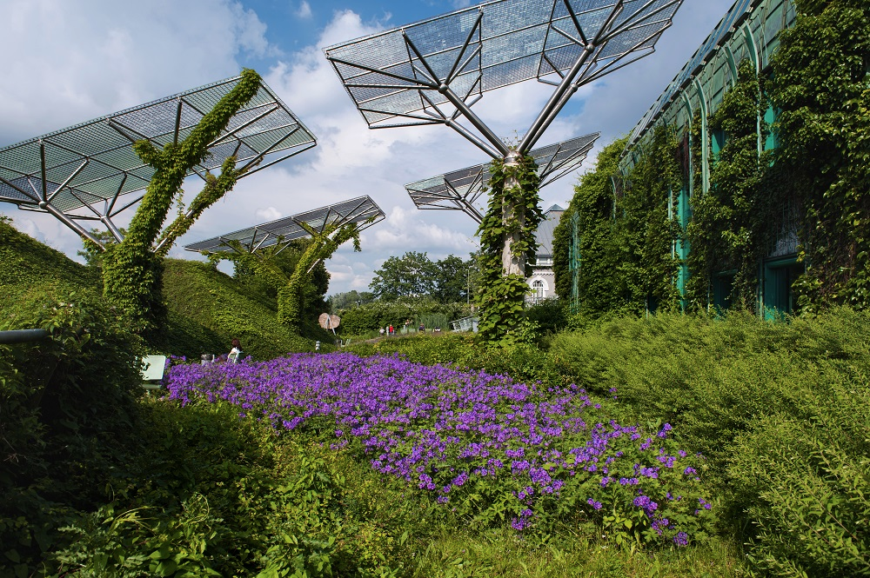
Urban Agriculture today examples:
House for Insects, Warsaw Poland
Wicker hance in the community garden,
Warsaw Poland
http://fundacjamy.com/in-english/projects-foundation-we-poland/community-gardens/

Slide 26
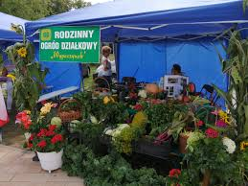
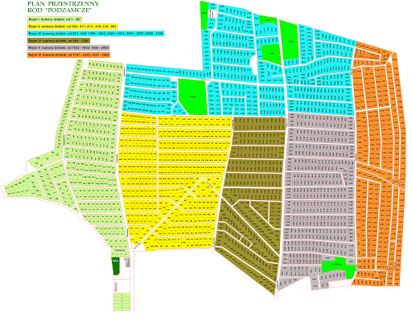
Urban Agriculture today - examples

Slide 27
Conclusion:
The challenges of urban agriculture
  UA could include soil contamination by heavy metals from the urban areas, which can be ameliorated through testing and decontamination.
  Economy of scale; can urban farming compete or replace rural large scale industrial farming? Availability of land as urban land is usually expensive. Alternative farming methods and technologies are thus required. Roof top farms, parks, brown fields, vacant lots, or planned urban agriculture belts.
  New urban areas can provide a solution to this challenge. Legal restrictions and economic impediments to access land and resources.
  There can also arise conflict with municipal greening policies such as tree crown cover targets, park area per capita targets among others.

Slide 28
Conclusion:
The challenges of urban agriculture
  Increasing Urban Food Production
    Feeding a Growing Society
    Hydroponics and Vertical Farming
  Rethinking the Supply Chain
    Transparency
    The Circular Economy
  Moving to Sustainable Consumption
    Changing Diets
    Food as a Service
  Managing and Eliminating Food Waste

Slide 29
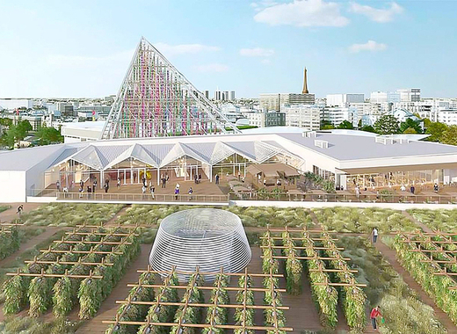
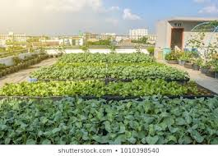
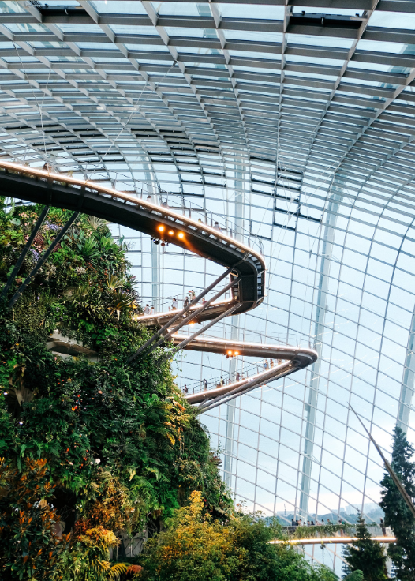
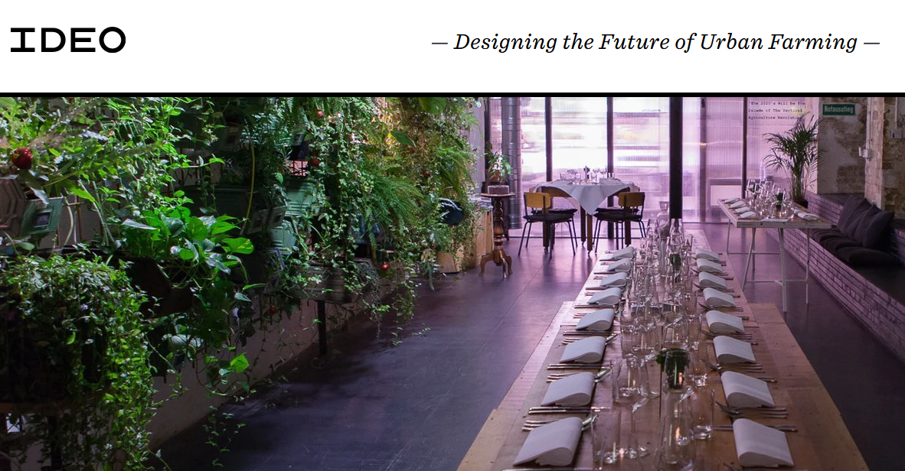
Urban Agriculture - Future
„SMART FARM FOR A SMART CITY”
https://foresight.arup.com/publications/arup-explores-urban-agriculture/
https://www.ideo.com/case-study/designing-the-future-of-urban-farming
https://design.agritecture.com/?utm_medium=agr-com&utm_source=popup

Slide 30
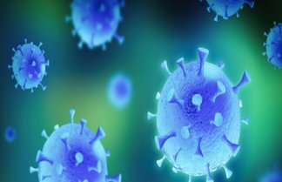
Conclusion:
The European Bank for Reconstruction and Development (EBRD)
  Invests in changing lives through their projects, business services and involvement in high-level policy reform.
  They are now committing with all their activity in 2020/2021 to help counter the economic impact of the Coronavirus pandemic. The Bank has announced an emergency coronavirus financing package worth €21 billion.

Slide 31
References:
Cobb, David (March 23, 2019). "Where are the Greens in the Green New Deal?". The Progressive. Retrieved December 04, 2020.
Kaufman, Alexander C (June 30, 2018). "What's the 'Green New Deal'? The surprising origins behind a progressive rallying cry". Grist. Archived from the original on November 13, 2018. Retrieved November 13, 2020.
Friedman, Thomas L. (April 15, 2007). "Thomas L. Friedman: The power of green". The New York Times Magazine.
Friedman, Thomas L. (January 19, 2007). "Opinion – A Warning From the Garden". The New York Times.
Jaśkiewicz J., Parlinska M., Rackiewicz I. (June 2020).” Wyzwania dla rolnictwa związane ze strategią Europejski Zielony Ład w okresie pandemii”.
Smit J., Nasr J., (1999) ."Urban agriculture for sustainable cities: using wastes and idle land and water bodies as resources"

Slide 32
Thank you for attention
Conference EUROPEAN GREEN DEAL FOR BIOECONOMY DEVELOPMENT
17 December 2020,

