Slide 1
Embryo Flushing and Transfer Methods in Cattle
Andris Grasbergs
Latvia University of Agriculture, Faculty of Veterinary Medicine, Latvia
Supervisor Ilga Šematoviča
Latvia University of Agriculture, Dr. med.vet., Docent
Jelgava, 2017
Govju ģenētisko resursu saglabāšana Latvijā pielietojot embriju transferenci un ar to saistītās biotehnoloģijas. Nr.1.1.1.1/16/A/025
Notes:
Hello, my name is Andris Grasbergs, I am 5th year student, my scientific advisor is Ilga Sematoviča.

Slide 2
Plan of the presentation
Aim of the research;
research methods;
embryo flushing and transplantation;
own experience;
conclusions
Notes:
Our scientific research is Embryo flushing and transfer methods in cattle.

Slide 3
Aim of the research
learn about embryo flushing and transfer methods;
compare methods;
Notes:
Aim of the research is to learn about embryo flushing and transferring methods, and compare them.

Slide 4
Research methods
analysis of literature;
analysis of own experience;
Notes:
my research methods were based on literature[literačur] analysis and analysis of my own experience flushing embryos.

Slide 5
Embryo flushing and transplantation (ET)
Provides an opportunity to reproduce the most valuable cow genetic potential using cows with less valuable genetic potential
Notes:
Whats actually is ET? embryo flushing and transplantation is a method which provides an opportunity to reproduce the most valuable genetic potential using cows with less valuable genetic potential.
Sounds easy!

Slide 6
Process consists of:
choosing a donor and a recipient;
hormonal synchronization;
flushing process;
embryo finding with stereomicroscope;
embryo evaluation;
transplantation or cryo conservation
Notes:
The whole process consists of six big parts. Each part has different methods and strategies. I would now like to tell you shortly about each part and main differences of methods.

Slide 7
1. Choosing a donor and a recipient
Donor:
aim:
increase productivity;
preserve genetic material;
pedigree;
exterior;
genital development;
diseases;
Recipient:
genital development;
diseases
Notes:
everything starts with choosing a donor and recipients.
first - we need to know the aim of why we want to get embryos. If the aim is to increase productivity then we choose the most perspective or the most productive animals.
If the aim is to save genetic material then we choose appropriate breed animal.
In both cases pedigree, exterior, genital development and history of diseases of the animals plays a major role , because for the donor we choose the best animals.

Slide 8
2. Hormonal synchronization
A
donors and recipients at the same ovarian phase;
superovulation for donors
serum gonadotropin of a pregnant mare (Foligon)
follicle stimulating hormone (FSH)
B
https://www.studyblue.com/notes/note/n/
A: normal ovary with follicle
B: superovulated ovary with
many corpus luteum
Notes:
Second part of the process is hormonal synchronization.
We need to make donors and recipients at the same ovarian phase, because flushed embryo is 7 days old, which means that the uterus of the recipient has to be in ovarian phase of a 7 day pregnant cow.
Second part of synchronisation is to achieve superovulation for donors.
Superovulation is controlled ovarian hyperstimulation inducing a cow to release multiple eggs in order to increase the number of embryos. There are two type medicaments to induce superovulation- Foligon and FSH

Slide 9
Days | Donors | Recipients
1 | PGF2α (Day 0)
15 | PGF2α | PGF2α
18 | Estrus (Day 0)
28 | Folligon
29 | - | PGF2α
30 | 08.00 PGF2α + 20.00 PGF2α
 | -
31 | -
32 | Estrus, 08.00 – 1st insemination + 20.00 – 2nd insemination | Estrus
33 | 8.00 – 3rd insemination if donor is in estrus
39 | Flushing of embryos | ET
Days | Donors | Recipients
1 | PGF2α (Day 0)
15 | PGF2α | PGF2α
18 | Estrus (Day 0)
28 | 08.00 FSH + 20.00 FSH
29 | 08.00 FSH + 20.00 FSH | PGF2α
30 | 08.00 PGF2α + 20.00 PGF2α
 | 08.00 FSH + 20.00 FSH
31 | 08.00 FSH + 20.00 FSH
32 | Estrus, 08.00 – 1st insemination + 20.00 – 2nd insemination | Estrus
33 | 8.00 – 3rd insemination if donor is in estrus
39 | Flushing of embryos | ET
Notes:
Here you can see two protocols how to manage synchronization for donors and recipients. In both protocols PGF2alpha is used. Inducing super ovulation is different in each protocol.

Slide 10
Foligon
+ 1 injection;
+ registred in Latvia;
+ bigger chance to get superovulation;
- poor embryo quality
- more unfertilized eggs
FSH
- 8 injections
- not registered in Latvia
- smaller chance to get superovulation (2/3)
+ better embryo quality
+ less unfertilized eggs
Notes:
Here you can see the advantages and disadvantages of each product.

Slide 11
3. Flushing process
preparation of donor cow:
locking;
control of superovulation (manual / laboratory);
epidural anestesia;
purge rectum;
washing the cow;
preparation of area;
flushing process:
surgical method / nonsurgical method;
2-way catheters / 3-way catheters;
with embryo filters / without embryo filters;
Notes:
Now I will tell you about flushing process. First part of the process is preparation which consists of many jobs. Process needs to be done as clean as possible.
During the flushing process different methods can be used . You can choose between surgical or non surgical method, use 2 or 3 way catheter, and using or not using embryo filters.

Slide 12
Surgical method:
+ better results;
+ accurate access to uterine horns;
- invasive method - laparotomy;
- recovery period;
https://wn.com/dorper_sheep_embryo
Notes:
Surgical method is historically oldest and nowadays rarely used.
(During laparotomy we can make direct approach to uterine horns. But method is invasive and painful for animal and is followed by recovery period after surgery.)

Slide 13
Non surgical method:
- difficulty in administration of catheter through cervix;
+ non invasive method;
+ suitable for farm conditions;
Notes:
The biggest problem using non surgical method is to administer catheter through the cervix, because flushing is at the 7th day of ovarian cycle, when the cervix is closed so you have to have experience.
This is a non invasive method and is suitable for farm conditions

Slide 14
3-way catheter
2-way catheter
http://www.bairnsley.com/breeding%20-%20et.htm
Notes:
Both methods are based on making an enclosed space at the cranial part of the uterus horn, infusion and extraction of the embryo flushing fluid thus flushing out the embryos from one uterine horn.
Using 3 way catheter we can make closed system. (- advantage-more sterile; disadvantage-slower fluid flow.)
Using 2 way catheter we use syringe to add fluid and at once extract out with same syringe.
(Advantage of this method-faster fluid flow, so there is a bigger chance to flush out all embryos; disadvantage-less sterile. )
From my experience-I used 2way catheter.

Slide 15
embryo filter
sediment
lower volume of fluid
embryos between clumps of mucus and epithelial cells
bigger volume of fluid
http://www.reproductionprovisions.com/Flushing-Filters_c277.htm
Notes:
To find the embryo it is possible to use a special embryo filter or you can just microscope the sediment of the washing fluid.
In some cases, also in my experience, it was harder to find embryos using the filter because you have to find them between clumps of mucus and epithelial cells that accumulate in the filter.

Slide 16
4. Embryo finding with stereomicroscope
exact, accurate work;
bigger and smaller petri dish;
http://www.amscope.com/led-trinocular-zoom-
stereo-microscope-7x-180x.html
http://www.banggood.com/65X15mm-p-997128.html
Notes:
After embryo flushing comes 4th big part - embryo finding.
This is very exact and accurate laboratory work.
After all embryos are found, follows next step…(next slide)

Slide 17
5. Embryo evaluating
Major role - experience
http://go.galegroup.com/ps/anonymous?p=AONE&sw=w&issn=15362302&v=2.1 &it=r&id=GALE%7CA186903306&sid=googleScholar&linkaccess=fulltext&authCount=1&isAnonymousEntry=true
Notes:
Embryo evaluating. In this part major role is experience. In picture you can see different embryo development from unfertilized egg to embryos with good quality. Differences between them are very small.
From my experience…

Slide 18
After evaluation embryos are placed in special straws and are ready to be :
transplantated or
cryo conservated
http://www.exodusbreeders.com/ProductDetail.jsp?LISTID=3E90000-1096379218
https://www.nature.com/articles/srep01173

Slide 19
6.1. Transplantation
Corpus luteum in recipients ovarium;
special gun;
cranial part of uterine horn;
https://www.enasco.com/action/Browse?item=C31165N&pm=1
Notes:
before transplanation we need to check recipients for corpus luteum, because not every recipient respond to hormonal synchronisation.
For embryo transplantation we use special gun, which is thiner.
The gun is moved through cervix, embryos are transplanted in cranial part of uterine horn.
This part is very similar to artificial insemination, but difference is - passage through cervix is very difficult, same like donors. Again-it requires a lot of experience.

Slide 20
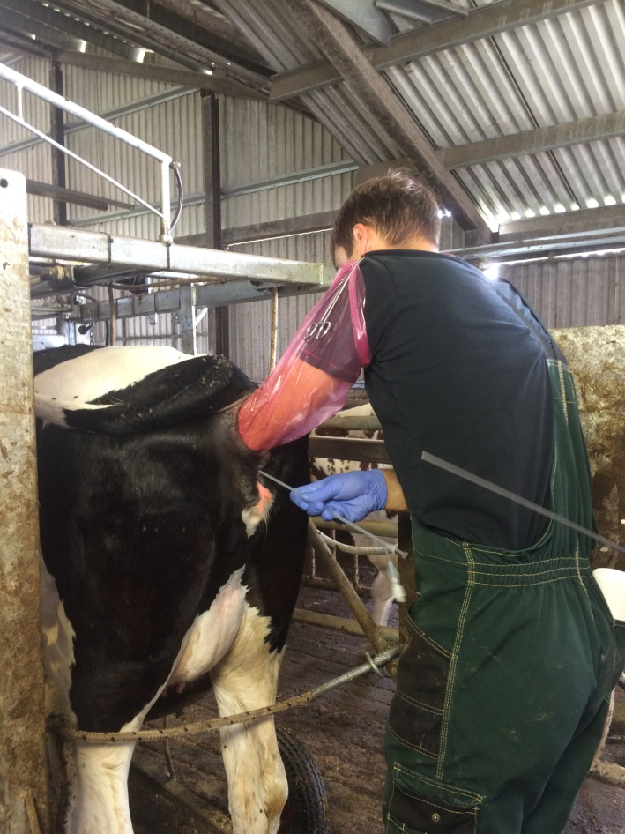
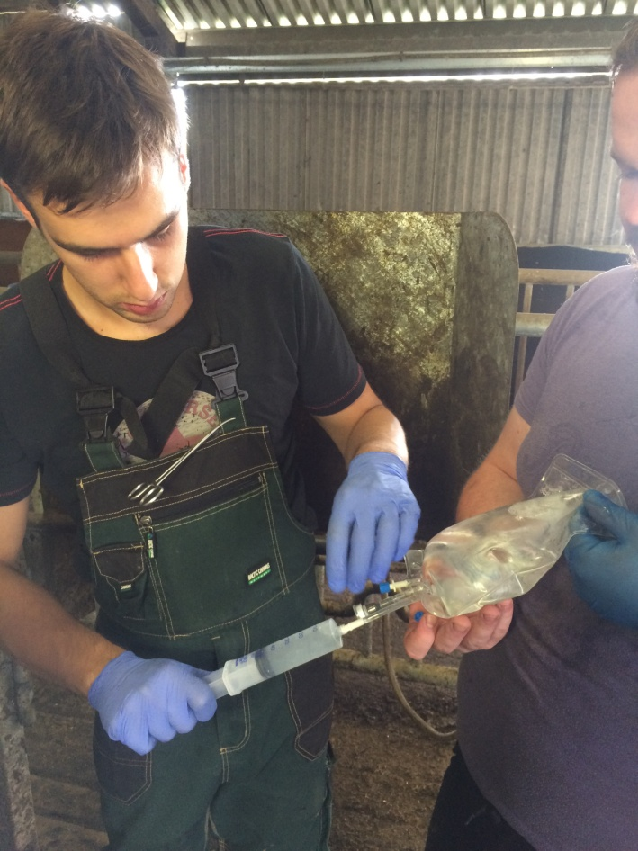
Own experience
2 flushing sessions;
in total 3 heifers and 1 cow were selected as donors;
4 transplanted embryos;
result - no pregnancies
Notes:
Now I will tell you about my embryo flushing experience.
it was done in lead of a veterinarian with ET experience last summer at my family's farm financed by our self.
From slide…
we found and transpalntated 4 embryos, which sounds great for first times.
But- result was unsuccessful

Slide 21
superovulation acquired using Foligon;
quality of superovulation was evaluated manually;
artificial insemination was done twice with double dose of sex-sorted semen;
flushing - nonsurgical, with 2-way catheter;
for one cow embryo filter was used;
Notes:
Superovulation was acquired using
(lāzers) This is how embryo looks like in microscope at first, and after magnification

Slide 22
Possible causes:
LACK OF EXPERIENCE;
incident in the process of flushing;
sex-sorted semen decrease result;
better embryo quality using FSH
lack of experience using embryo filters
Notes:
Main possible cause for unsuccessful result is the lack of experience. All process requires big experience, specially catheter passage through cervix and laboratory work.
In last embryo flushing session, we had bad incident - in the end of flushing last uterine horn, epidural anesthesia lost effect and cow defecated in our work area, right in fluid with all flushed content with embryos. Fecal contamination in embryo fluid is toxic.
Other cause - we used sex sorted semen, witch decrease result.
Also we used Foligon for superovulation - literature source shows a better embryo quality and better results using FSH.

Slide 23
Conclusions
perspective method to reproduce the most valuable genetic potential;
method requires exact work following the guidelines strictly;
experience plays great role;
Notes:
ET is

Slide 24
References
Carlos R. F. Pinto "Embryo Transfer In Cattle", 2014
Hasler, J. F. "Forty years of embryo transfer in cattle: A review focusing on the journal Theriogenology, the growth of the industry in North America, and personal reminisces" Theriogenology, 2014, 81(1), 152–169
Dr. Heinrich Tenhumberg "Bovine Embryo Transfer" Minitube protocol, 2013

Slide 25
THANK YOU FOR YOUR ATTENTION
From left: Andris Grasbergs, Jānis Grasbergs, Dārta Larionova, Egils Juitinovičs, Marta Barbara Bergmane, Andris Auniņš, Lauris Štelfs

