Slide 1
Promotion of water resource sustainability for tourism and attractiveness of CBC of Rēzekne & Ostrov Sticky urban areas
Project partner - Latvia University of Life Sciences and Technology (LLU)
Šī publikācija ir sagatavota ar Latvijas-Krievijas pārrobežu sadarbības programmas 2014.-2020.gadam finansiālu atbalstu. Par tās saturu pilnībā atbild Rēzeknes pilsētas dome un tā var neatspoguļot Programmas, Programmas dalībvalstu Latvijas un Krievijas, kā arī Eiropas Savienības viedokli.
Programmas mājas lapa: www.latruscbc.eu

Slide 2
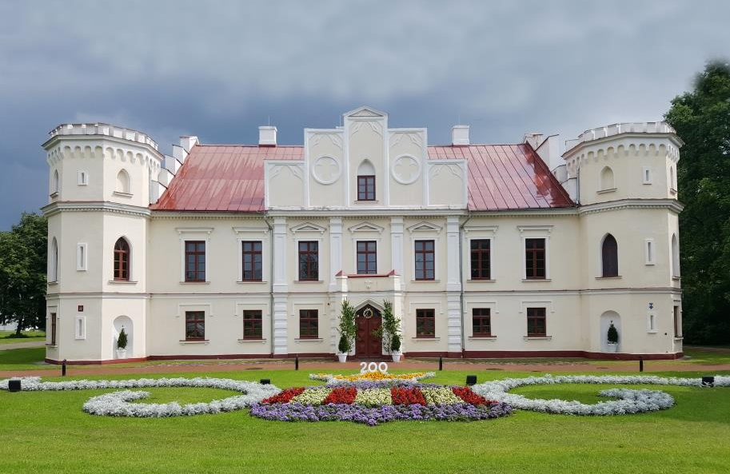
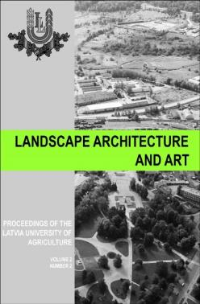
Landscape architecture studies in LLU
25 year anniversary of landscape architecture in Latvia
All study levels (bachelor, master, doctor)
Total number of students – 125
Department of Landscape Architecture and Planning – staff – 15 academics and researchers
International scientific journal «Landscape Architecture and Art» (ind. SCOPUS, WoS)
http://llufb.llu.lv/Raksti/Landscape_Architecture_Art/

Slide 3
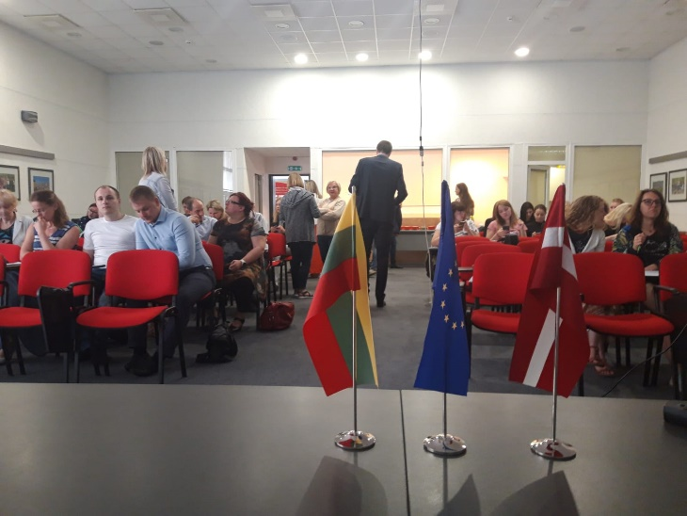
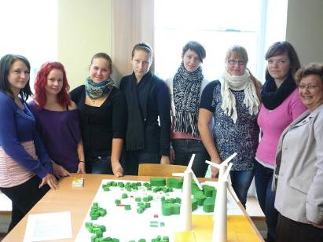
Prevous experience in similar projects
Project experience for workshops and seminars
Innovative brownfield regeneration for sustainable development of cross-border regions BrownReg (Interreg Latvia-Lithuania cross-border cooperation programme 2014-2020) http://www.vbf.llu.lv/lv/innovative-brownfield-regeneration-for-sustainable-development-of-cross-border-regions-brownreg
Creation of Joint GI Education to Increase Job Opportunities in the Region (Interreg Latvia-Lithuania cross-border cooperation programme 2014-2020)
Increasing capacity of electronic materials about climate changes in rural areas (EEA financing mechanism “National Climate Policy” ) https://estudijas.llu.lv/course/view.php?id=1474 https://estudijas.llu.lv/course/view.php?id=1479 https://estudijas.llu.lv/course/view.php?id=1640
Practical Training for planners in Zemgale Planning Region and North Lithuania. Sustainable planning of green areas in the cities (Latvia-Lithuania cross-border cooperation programme) https://www.zemgale.lv/informativie-materiali/category/23-bukleti
Climate Change Information Activities in Schools (Climate Change Financial Instrument ) https://estudijas.llu.lv/course/view.php?id=319

Slide 4
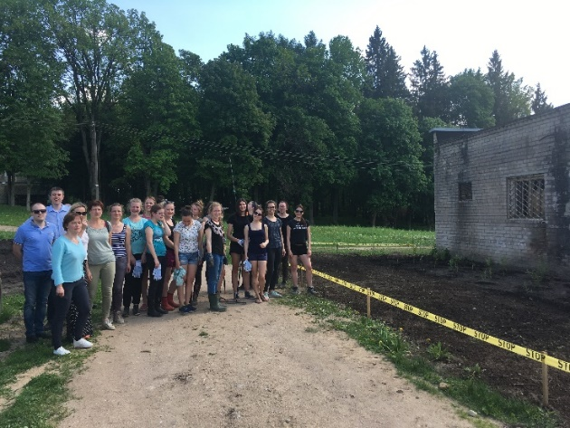
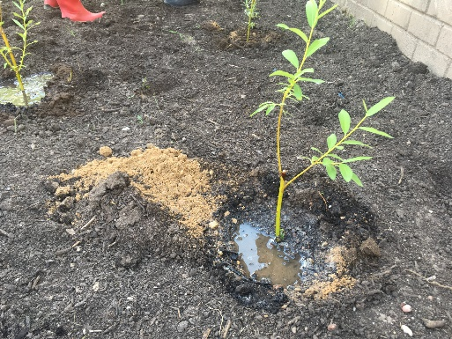
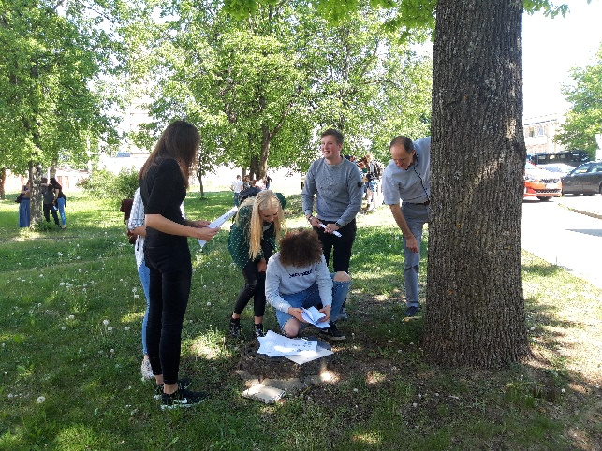
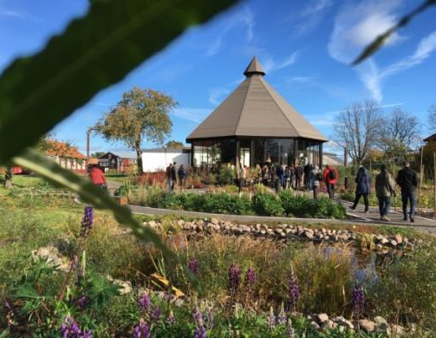
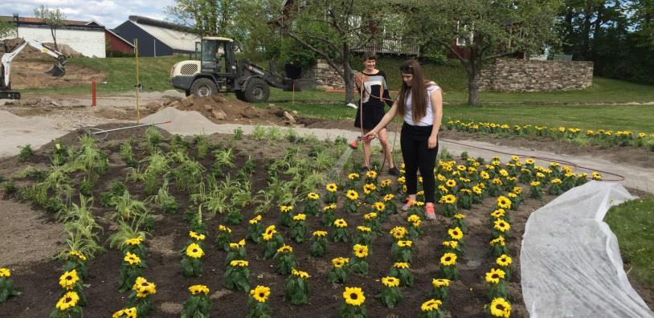
Prevous experience in similar projects
Project experience for students and public involvement in project activities
Revitalization of brownfield areas. Phytoremediation plants were planted on pilotareas in Ludza (LV), Kupiskis and Ignalina (LT) within the international cooperation project Innovative brownfield regeneration for sustainable development of cross-border regions (Interreg Latvia-Lithuania cross-border cooperation programme 2014-2020)
Participation in the development of
phytoremediation park in Orrefors,
Sweden – former glass industry (heavy metal
contamination with lead and arsenic)

Slide 5
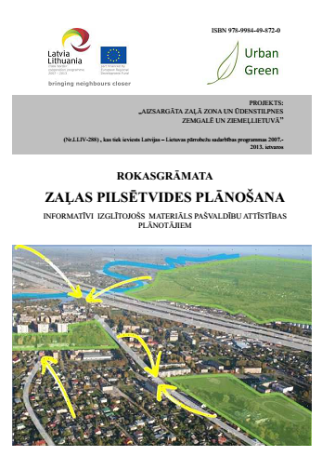
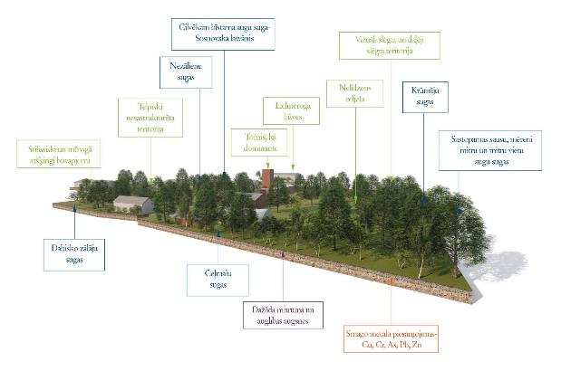
Prevous experience in similar projects
Guidelines and manuāls / development scenarious
Book Use of Phytoremediation in Latvia
Book Urban Green Planning (Lat-Lit / Urban Green) https://www.zemgale.lv/informativie-materiali/category/23-bukleti
Brownfields remediation best practice guidelines book and development scenarious for pilotareas

Slide 6
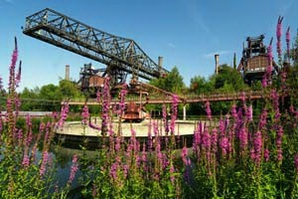
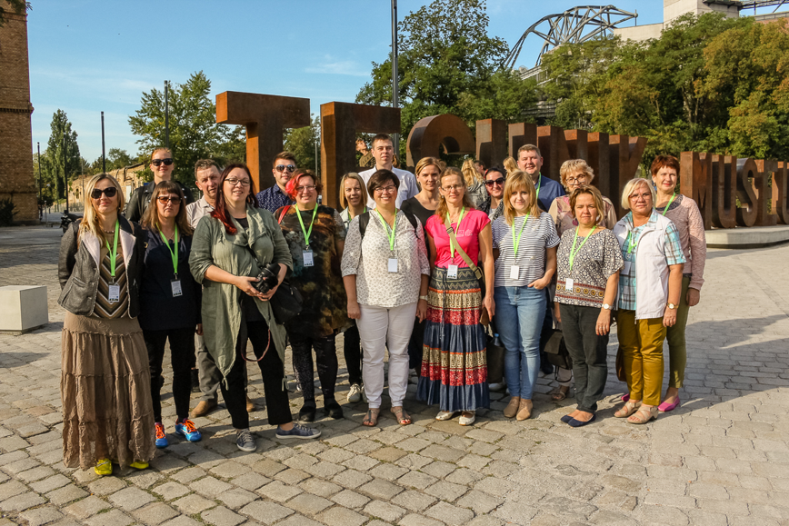
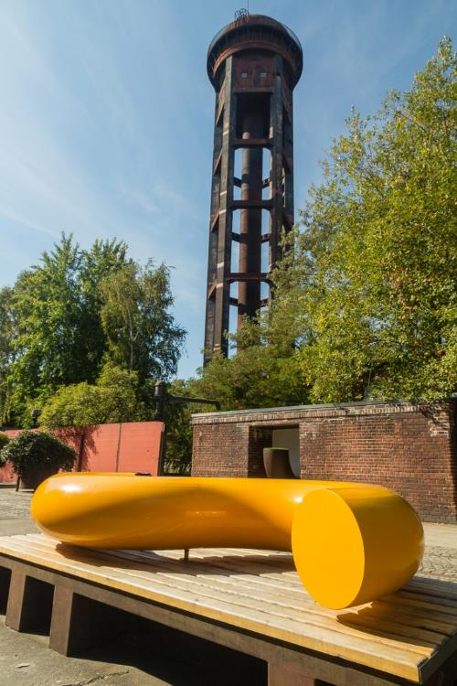
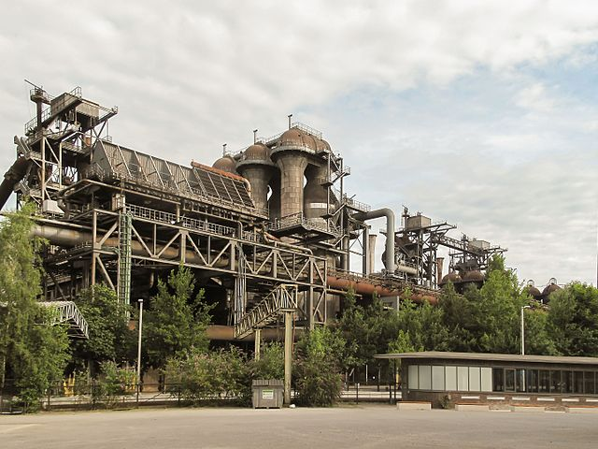
Prevous experience in similar projects
Best practice experience trip
within the international cooperation project Innovative brownfield regeneration for sustainable development of cross-border regions (Interreg Latvia-Lithuania cross-border cooperation programme 2014-2020)
The aim of the trip is introduce municipality planners, professionals and university researchers with best practice examples of revitalized post-industrial areas in Poland and Germany, Ruhr region, Duisburg etc. – all partners

Slide 7
The role of LLU in the project
Transferring of knowledge into practice
Manual for Integrated nature resource management will be elaborated by working together with municipalities and universities, as well as activities for public involvement will take place, so, it will help to bring the new knowledge obtained within the project activities to different target groups (professional for the sector, municipalities, inhabitants, students, etc.) afterwards, thus provide sustainability of the project results.

Slide 8
Planned activities in the project (1)
Activity package 1 Management
Everyday communication, video conferences etc.
Participation in kick-off meeting, PWG and PSC meetings, programme events and seminārs
Reporting
LLU contact persons
For project documents, finances – Julija Mangale (julija.mangale@llu.lv, +371 26190987)
For project activities – Daiga Skujāne (daiga.skujane@llu.lv, +371 26522344), communication in Russian – Natalija Nitavska (natalija.nitavska@llu.lv, +371 26442753)

Slide 9
Planned activities in the project (2)
Activity package 2 Visibility and Communication Activities
Project profile in LLU web page
Posts in social media and LLU web page
1 information poster at LLU premises and 1 roll-up
Video material about the project activities implemented by LLU (December 2020 – February 2021)
Tourism route “Eco quest” (March – May 2021)
Two interactive tourism routes will be created that will include questionnaires - answers to these will be found on PPs web pages and in the improved river bank areas.

Slide 10
Planned activities in the project (3)
Activity package 3 Capacity building of public sector professionals of tourism and integrated resources management (1)
2 day capacity building workshops in Rezekne (September 2019 – February 2020) and Ostrov (December 2019 – May 2020)
Universities are responsible for 5 experts involvement and academic background for workshops. During workshops the participants:
will get acquainted with the main principles, systems and tips in integrated nature resources management for the overall area development, learn about international best practices and the impact that urban planning has on the overall economic and tourism development of an area;
Will elaborate basic principles for development of Blue Passport for water bodies of Rezekne and Ostrov
Will elaborate basic principles for planning new tourism routes
Materials developed within the framework of the workshops will be translated (responsible – Rezekne) and available in e-format (LLU web page)
Workshop in Rezekne will be organized by LLU in cooperation with Rezekne
5 scholars from LLU will take part in workshops

Slide 11
Planned activities in the project (4)
Activity package 3 Capacity building of public sector professionals of tourism and integrated resources management (2)
Development of Integrated nature resources management manual (September 2019 – February 2021)
Will include topics: effective management of nature resources, promotion of tourism development and balance between economic activity and ecosystem sustainability. The theoretical part of the manual will be based on developed materials for the training programme. Included information will be supported with practical examples from LV-RU cross-border region, as well as best integrated water resource management examples from Europe.
The manual will also include approaches for municipalities on the process of integrated natural urban water body management implementation, maintenance of the balance between fast development and ecology, which is one of the main factors for eco-tourism.
Will be translated in English (responsible - Rezekne) and Russian (responsible – Ostrov) and available in e-format and printed (for dissemination) (responsible – LLU)

Slide 12
Planned activities in the project (5)
Activity package 3 Capacity building of public sector professionals of tourism and integrated resources management (3)
Integration of project findings in study courses and approbation (December 2020-May 2021)
At least 100 students from LLU will receive information on project topics through:
study courses – Nature landscape design; Landscape Ecology and Environmental protection; Water landscape (Spring semester 2021)
Scientific practical conference “Sustainable Water Design” 04.2021.
Materials available on LLU website
Topics of the project | Study courses in which topics will be included
development of tourist routes in nature areas | Nature landscape design
Sustainable management of nature resources | Landscape ecology and environment protection,
Planning of riverfront for tourism and water protection | Water landscape

Slide 13
Planned activities in the project (6)
Activity package 4 Capacity building of tourism sector professionals and development of platform for tourism development (1)
Event “Green Lab” (June 2019 – November 2019)
GREEN LAB events (one in Rēzekne and one in Ostrov) will be organized by project partner universities with public participation and students involvement from both universities. During GREEN LABS the participants will study river banks, perform monitoring procedure, develop procedure on how to react to environmental changes. Through ArcGIS and newly gained data main environmental threats will be assessed to provide suggestions in adapting possible environmental challenges to support an increase in the number of visitors in these areas. During the GREEN LABS events urban waterfront rain garden vegetation (specially selected and planted in strategically chosen locations) will be planted.
5 scholars and 20 students from LLU will take part in the event in Rezekne and 5 scholars and 10 students will take part in the event in Ostrov.
LLU will purchase an equipment for environmental and water quality assessment

Slide 14
Planned activities in the project (6)
Activity package 4 Capacity building of tourism sector professionals and development of platform for tourism development (2)
Research “Preventing water body pollution and flooding” and development of “Blue passports” (December 2019 – November 2020); Regional tourism routes “Blue way” (March 2020 – November 2020)
After both Green lab events PP universities will jointly develop a study, providing a set of solutions to prevent flooding and water body pollution and accommodate increasing number of visitors. Both universities will elaborate BLUE PASSPORTS - extensive descriptions on both project sites (Rēzekne in Latgale region and Ostrov in Pskov region), including historical background, biodiversity data, water body monitoring data, accomodations for increased environmental resilience and suggestions for sustainable tourism routes and attractions. The route "BLUE WAY" will be developed and available both as part of the BLUE PASSPORT and in electronic format.
At least 20 students from landscape architecture field (LLU) will be involved in the research and development of blue passports and tourist routes Rezekne.
LLU will purchase an equipment – 2 laptops (with software) and 3 memory (1TB)

Slide 15
Planned activities in the project (7)
Activity package 4 Capacity building of tourism sector professionals and development of platform for tourism development (3)
2- day trainings for tourism actors / entrepreneurs in Rezekne (March 2020 – August 2020) and Ostrov (June 2020 – November 2020)
5 scholars from LLU will take part in trainings and will learn about tourism clusters, marketing, develop marketing strategies. Project partner universities will help develop marketing suggestion material for entrepreneurs.

